Slide 1
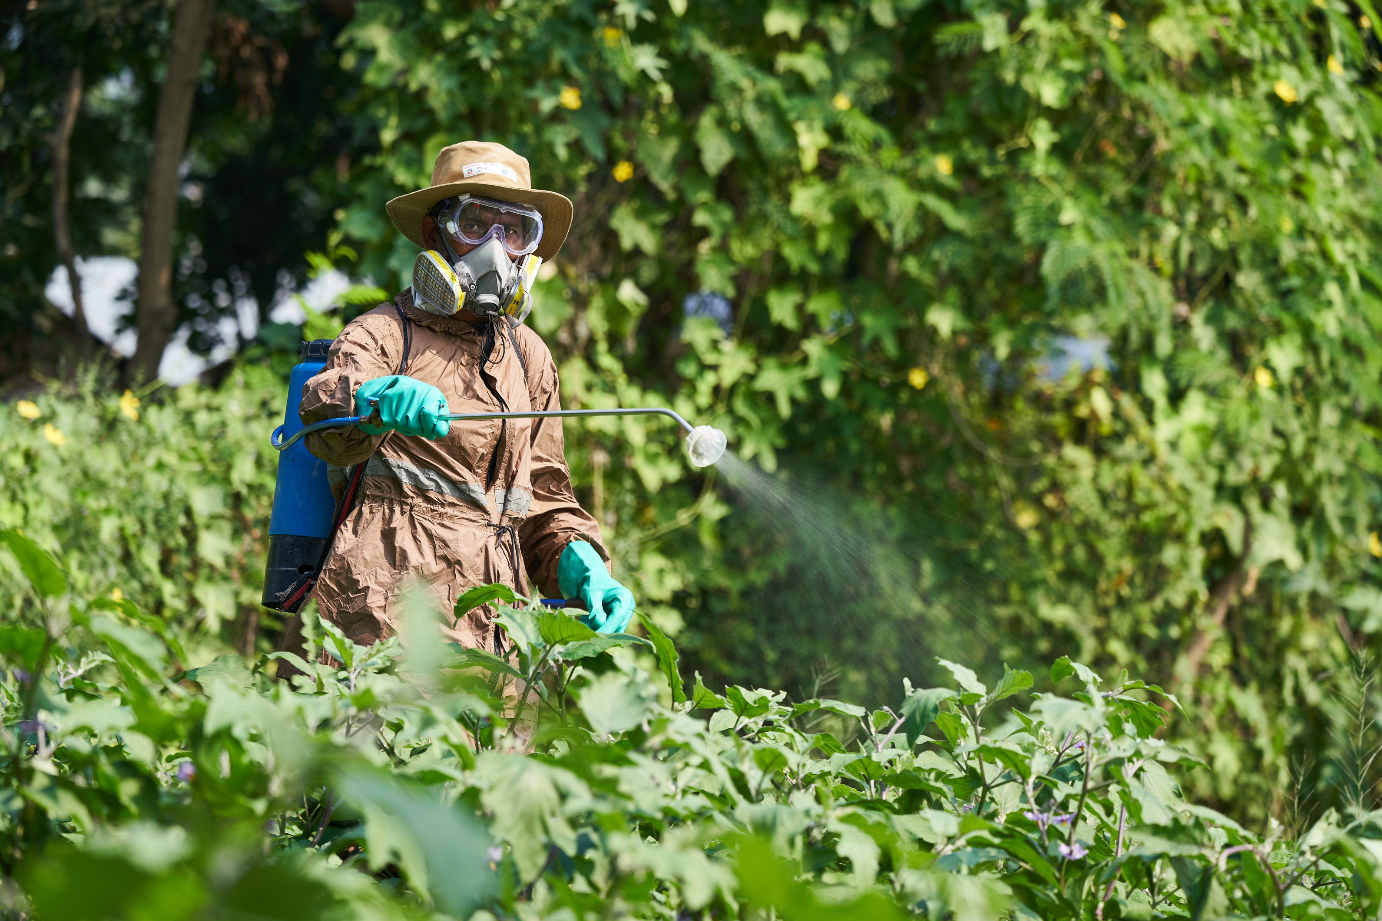

Médecins du Monde France
45 YEARS OF FIGHTING FOR ACCESS TO HEALTHCARE
INTEGRATING OCCUPATIONAL HEALTH AND SAFETY (OHS) SERVICES IN PRIMARY HEALTHCARE SYSTEM:
LESSONS LEARNED FROM INFORMAL WASTE WORKERS
AND FARMERS PROGRAMMES IN NEPAL
11th April 2025
11th National Summit of Health and Population Scientists in Nepal
Mahesh Prasad Joshi, Program Manager, MdM France in Nepal

Slide 2
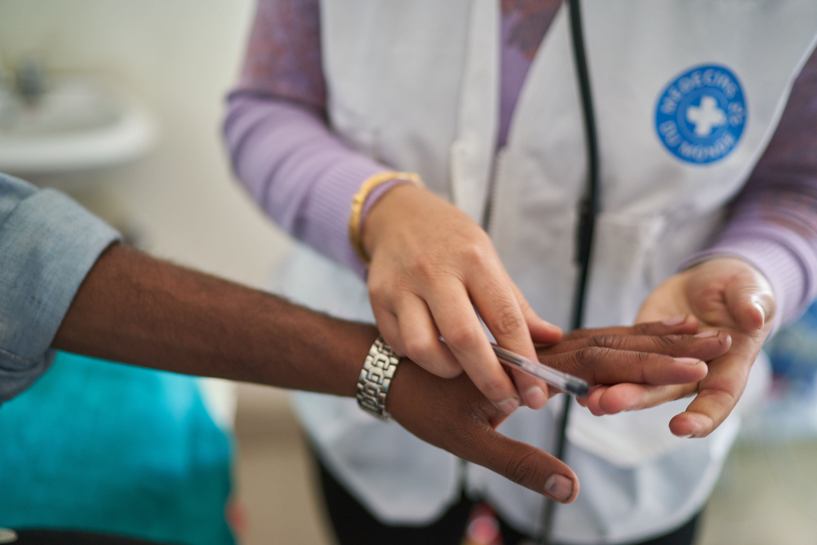
Outlines
01
Understanding Occupational Health and Safety (OHS)
02
Environment & Health (EH) Interventions of MdM France in Nepal
03
Intervention Framework
04
Challenges
05
Ways forward

Slide 3
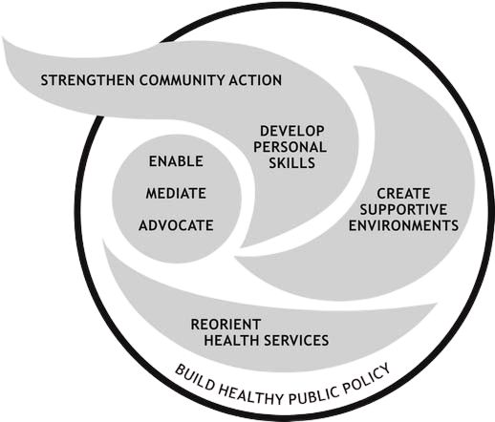

Understanding Occupational Health and Safety (OHS)
Comfort
Triads of ergonomic element
Health
Productivity
Ottawa Charter for Health Promotion -1986
Ref:
The SDG 3 aims to “Ensure healthy lives and promote
well-being for all at all ages”
The SDG 8 aims to “Promote sustained, inclusive and
sustainable economic growth, full
and productive employment and
decent work for all”

Slide 4
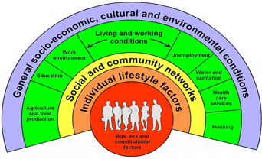
Understanding OHS-Social Determinant Perspectives
Source: Dahlgren-Whitehead, 1991

Slide 5
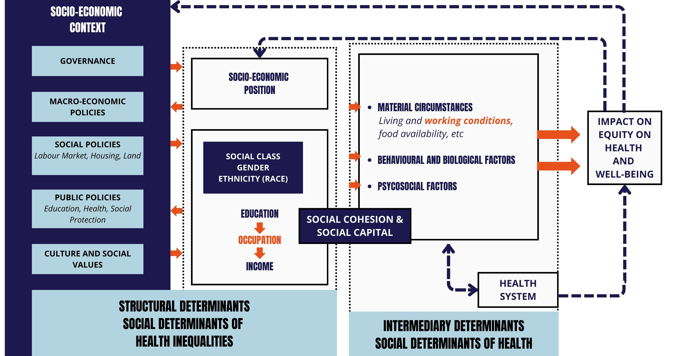
Understanding OHS-Social Determinants Perspectives
A Conceptual Framework for
Action on the Social Determinants
of Health: WHO 2010

Slide 6
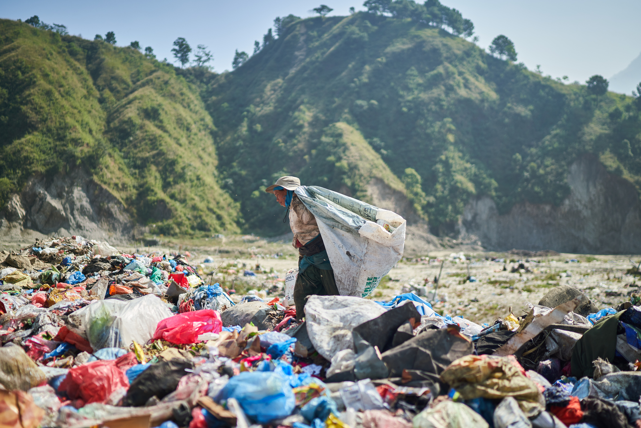

The Occupational Health “Cycle of Neglect”
01
Occupational health is a low priority
Existing Labour Acts and OHS policies have limited scopes – not addressing the needs of informal workers, i.e. 41% GDP contribution in 2025
Increasing vulnerability
Environmental conditions, precarious working conditions, poor health access and awareness
05
02
Limited resources
Absence of occupational health and safety promotion, prevention, consultations and treatment protocols in the national health system.
04
03
Limited allies and partners
Only few organizations working in OHS for the vulnerable communities
Inadequate information & evidence
  No robust system to collect and exchange occupational health and diseases-related data
  Limited scientific studies to measure the prevalence of occupational health diseases with respect to precarious working environment.
Adapted Nuwayhid 2004

Slide 7

OHS risks among IWWs and Farmers
The studies among waste workers suggested that all of them are exposed to many occupational health risks in their working day, such as from solid waste, toxic fumes, physical exertion, air pollution, handling hazardous waste like medical waste etc.(1) Similarly, some studies highlighted the increase in prevalence of respiratory and musculoskeletal symptoms among waste and brick workers and hearing loss among textile workers. (2,3)
Farmers are vulnerable due to risks associated to pesticide exposure, physical exertion, injuries and long-term exposure to extreme heat and cold. (4)
According to study done In Nepal by Utyasheva L et. al. in 2020 it is highlighted that nearly 24% of suicide deaths were related to poisoning which are mostly Agricultural pesticides.(5)
A baseline survey conducted by MdM and TGH jointly in 2024 showed that 94.5% (N=236) of farmers use chemical pesticides in selected wards of Kavre, Ramechhap and Sindhupalchowk districts.

Slide 8
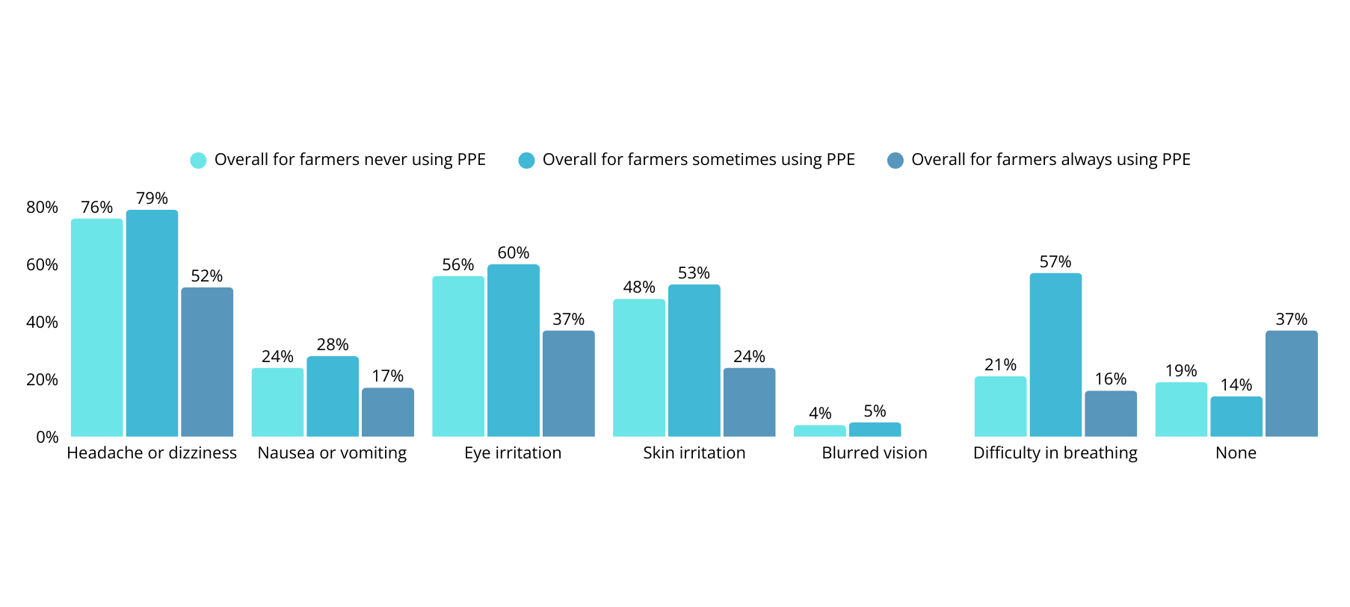
Key findings
Symptoms experienced by farmers who use chemical pesticides
Reference: MdM-TGH Consortium - SFVC Project, Baseline Survey 2024

Slide 9
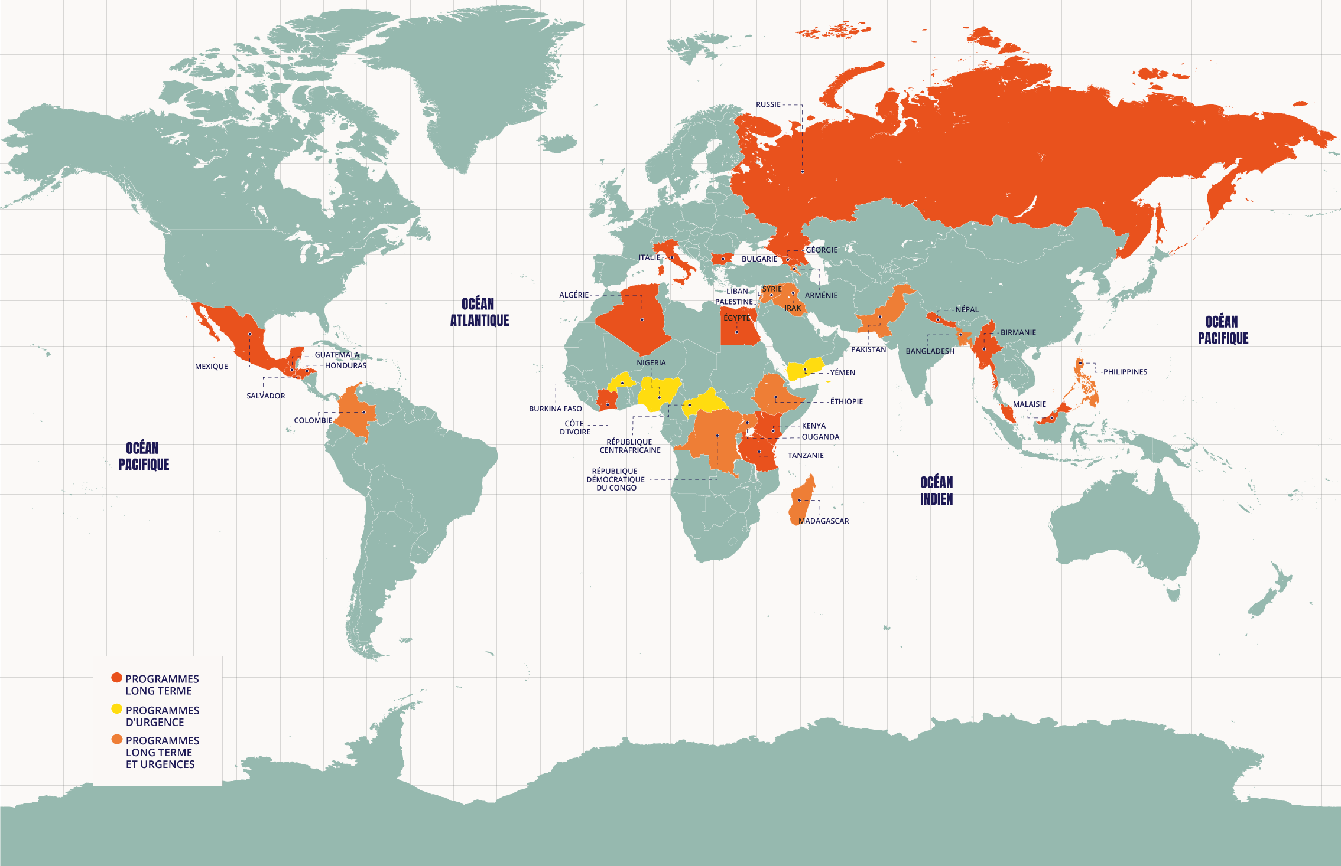
About Médecins du Monde France
Médecins du Monde France (MdM-F) is a globally recognized medical organization founded in 1980 that tirelessly defends a fair and universal health coverage. We fight through actions and health rights, from our advocacy and field work through 59 programmes in France, and internationally in 30 countries
MdM’s 6 Thematic Areas – Globally
Healthcare Systems and Rights
Migration, Exile, Rights and Health
Harm Reduction
Sexual and Reproductive Health and Rights
Humanitarian Space
Environment and Health (EH)
“We provide care, bear witness, and advocate for social change, also fighting injustice. We work collaboratively to ensure universal access to healthcare. Around the world, we enable people whose health is in danger to access quality medical services.”
MdM operates through 17 Chapters globally.

Slide 10
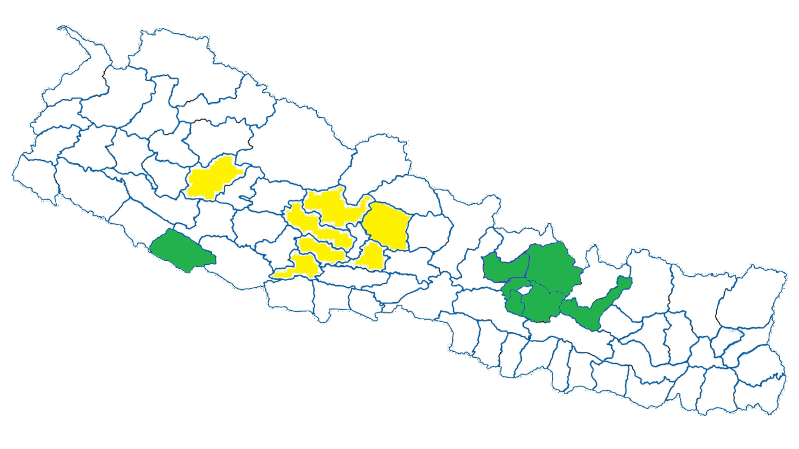


MdM’s EH interventions in NEPAL
MdM started its work in Nepal since 1995, and in EH since 2018
2018-20
2020-21
Healthy Waste Workers project in Kathmandu and Nuwakot districts
1 Emergency Covid Response
2 Healthy waste workers project Kathmandu, Nuwakot and Banke districts
EH Project (KTM)
Kathmandu and Nuwakot
2020-25
1 Healthy waste workers in 3 Districts
2 Pesticide risk mitigation among farmers in 4 districts
3 Jajarkot Earthquake Response project 2023-24
SFVC Project (KAVRE)
Kavre, Ramechhap, Sindhupalchowk
SOEH Project (NPJ)
Banke
2024-27
Index:
1 Promoting occupational and environmental health, health system
2 Strengthening Social health protections
3 Emergency Flood Response Activities in Kathmandu
Current districts of interventions
Kavre, Ramechhap, Sindhupalchowk, Lalitpur, Kathmandu, Nuwakot, Banke
Past districts of interventions
Myagdi, Parbat, Baglung, Gulmi, Syanja, Argakhachi, Jajarkot

Slide 11

MdM’s EH Interventions
Community-based SBCC sessions among the farmers/waste workers group led by leaders/FCHVs
01
06
CSOs strengthening
PPEs provisions for the farmers
and waste workers in their precarious working conditions
02
Promoting personal hygiene, environmental sanitation, and first-aid to mitigate occupational risks/hazards
OHS of the farmers
and waste workers
TD Vaccination for the farmers
and waste workers
OHS consultations for the farmers
and waste workers through supported HFs by trained
Health workers
05
03
04
Support in Enrollment of the farmers and waste workers in the Health Insurance Program of the Nepal Government
*Support HFs - medicines, supplies and equipments
*Capacity building training to health workers

Slide 12


  Health System Characteristics​
  Local health policies​
  Governance and Accountability​
  OHS reporting System​
  Budgeting for OHS programs​
  Community Engagement​
  Interventions
  SBCC sessions​
  Provision of PPEs​
  Health workers training on OHS​ & consultation service
  Drugs and medical supplies​
  Vaccinations (TD)​
  Enrollment in HIP​
  Networking and formalization initiatives​
  Policy advocacy
  Adoption System
  Project Participants
  Health Workers​
  Public Health Professionals
  Policy makers​
  Stakeholders including community groups and CSOs​
Integration
Framework
  Problem
  Poverty, Informality and Limited recognition​
  High risk workplace/work​
  Environmental pollution (water, soil and food)​
  Lack of OHS integrated quality health services​
  Limited policies and programs to address OHS needs​
Broad Contextual Factors​
Demographic, Economic, Political, Legal, Ecological, Socio-cultural, Technological​
Adapted from Atun R. et. al. 2010

Slide 13
Challenges
Many informal waste workers prioritize immediate income over safety, leading to poor adoption of OHS practices.
Due to the unavailability of OHS services within the existing health system, occupational health aspects are being overlooked, resulting in missed opportunities for early detection and prevention of occupational diseases.
Standardization of guidelines, tools and policy reflection.
Institutional mechanism for technical support and backstopping to local government
Limited Resources

Slide 14
Ways forward
Integrating OHS services in PHC results in increased intersectoral collaboration, contributing to translate “Health in all Policies (HiAP)” into action ensuring OHS needs of the informal sectors and support to achieve universal health coverage.
There is an urgent need for a national-level discourse and initiative to promote OHS and ensure the institutionalization of OHS preventive and promotive services in the primary health care system, e.g., Technical leadership of health sector on OHS, feasibility assessment to integrate Occupational data in HIS, scale up initiatives of OHS integrated BHS.
Collaboration among government authorities, employers, trade unions, workers, and stakeholders to ensure a coordinated and multi-faceted approach to OHS e.g. Formalization Initiatives, 4P Model [Public-Private and People’s Partnership-4P Model].
Co-build mechanisms such that local governments can implement OHS integrated health services for the public including the informal sector workers.
Standardization of health (OHS) and safety measures, promote locally adapted measures.
Allocate resources for further R&D in OHS to advocate for policy reforms and service delivery.

Slide 15
REFERENCES
(1) Black M, et al. The health risks of informal waste workers in the Kathmandu Valley: a cross-sectional survey. Public Health. 2019;166:10–8.
(2) Sanjel S , Khanal SN , Thygerson SM , Khanal K , Pun ZD , Lama S , Joshi SK . Epidemiology of Work-Related Musculoskeletal Symptoms and Illnesses among Brick Kiln Workers in Kathmandu Valley, Nepal. Kathmandu Univ Med J (KUMJ). 2018 Apr-Jun;16(62):138-145.
(3) Mansouri F, Pili JP, Abbasi A, Soltani M, Izadi N. Respiratory problems among cotton textile workers. Lung India. 2016 Mar-Apr;33(2):163-6.
Ekmekci, M., Yaman, S. Occupational health and safety among farmers: a comprehensive study in Central Anatolia, Turkey. BMC Public Health 24, 2732 (2024).
(4) Rifat Atun, Thyra de Jongh, Federica Secci, Kelechi Ohiri, Olusoji Adeyi, Integration of targeted health interventions into health systems: a conceptual framework for analysis, Health Policy and Planning, Volume 25, Issue 2, March 2010, Pages 104–111.
(5) Utyasheva, L., Sharma, D., Ghimire, R. et al. Suicide by pesticide ingestion in Nepal and the impact of pesticide regulation. BMC Public Health 21, 1136 (2021).
(6) United Nations, Sustainable Development Goals 2015.
(7) National occupational safety and health profile for Nepal. International Labour Organization and Ministry of Labour, Employment and Social Security 2022.

Slide 16
ACKNOWLEDGMENTS
  Project participants (IWWs and Farmers)​
  Ministry of Health and Population (MoHP)​
  Social Welfare Council (SWC​)
  Plant Quarantine and Pesticide Management Center (PQPMC)
  Local Governments (Kathmandu Metropolitan City, Nepalgunj Sub Metropolitan City, Dhulikhel Municipality, Mandandeupur Municipality, Kakani RM, Likhu Tamakoshi RM, Panchpokhari Thangpal RM, Duduwa RM, Khajura RM)
  Agence Française de Développement (AFD)
  Deutsche Gesellschaft für Internationale Zusammenarbeit (GIZ)
  Triangle Génération Humanitaire (TGH) ​
  UHPCs, Health Facilities ​and Health Workers
  Partner NGOs Samyukta Safai Jagaran (SASAJA), Bheri Environment Excellence Group (BEE Group) and Farmers for Rural Development (FRDEV)​

Slide 17

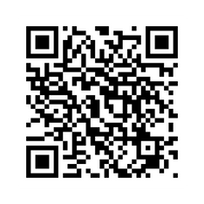
Médecins du Monde France
45 YEARS OF FIGHTING FOR ACCESS TO HEALTHCARE
Santé et environnement au Népal​
MÉDECINS DU MONDE​
www.medecinsdumonde.org​
Twitter : MdM_France​
Instagram: @médecinsdumonde​
Facebook: Médecins du Monde France​
For more information:
www.medecinsdumonde.org​

Slide 18
Biography
  Mahesh Prasad Joshi is the Program Manager at Médecins du Monde (MdM) – France. Over 12 years of experience in public health and social development sectors in Nepal. Holds postgraduate degrees in Public Health and Sociology. Actively involved in policy advocacy, research, and program implementation with a focus on health system strengthening, social security, and reducing social inequalities. Strong interest and commitment to promoting social equity and improving health rights.

