Slide 1
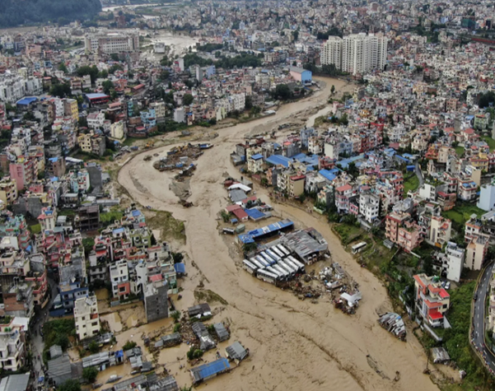
Building Climate Resilient Health System in Nepal:
Achievements and Way Forward
Raja Ram Pote Shrestha
WHO Country Office for Nepal
11 April 2025

Slide 2
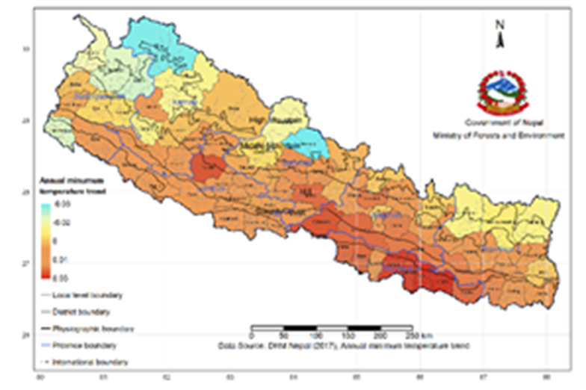
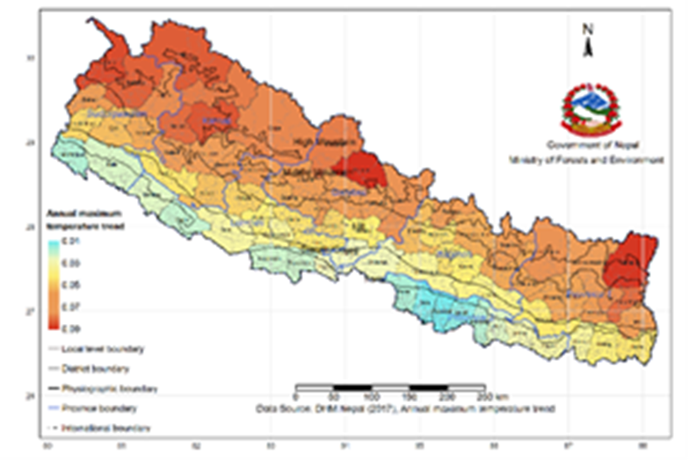
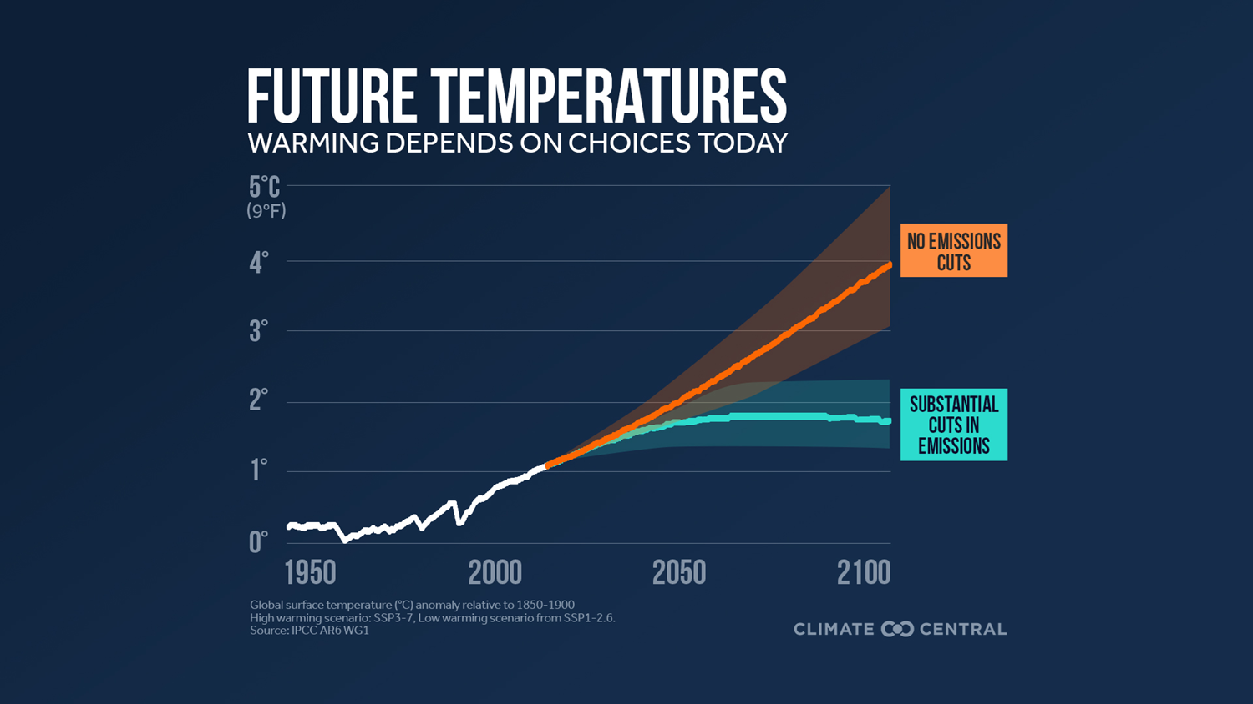
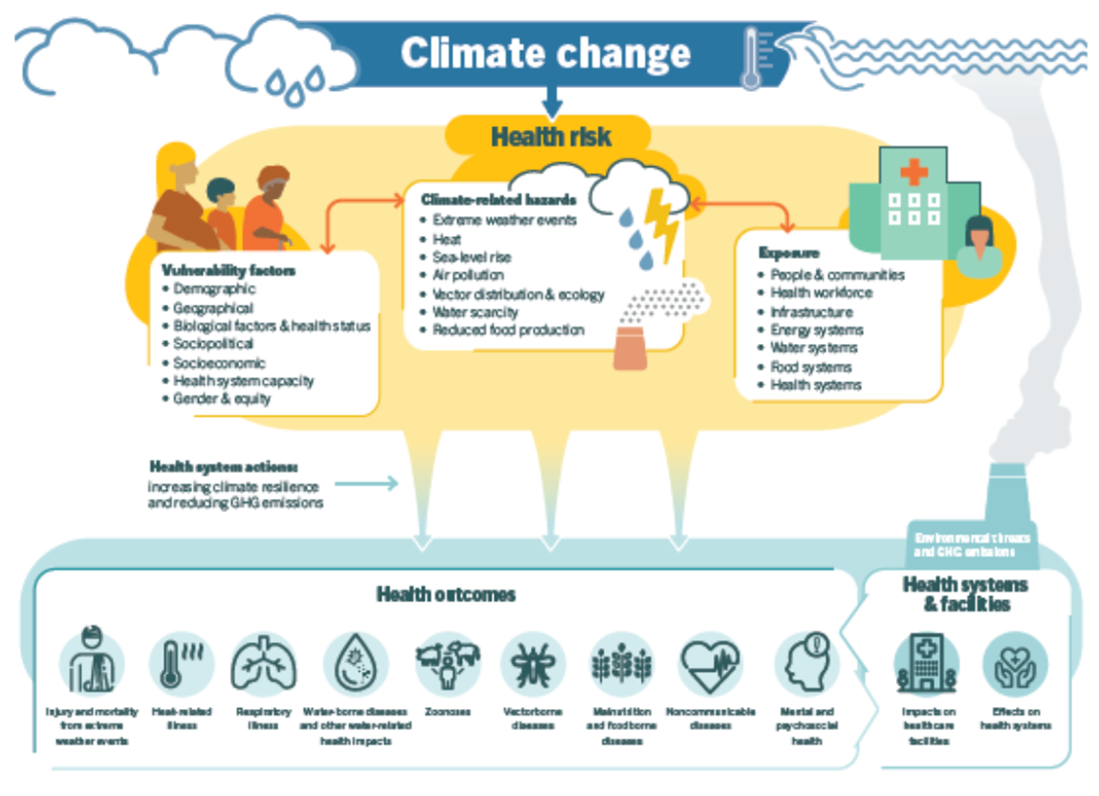

Slide 3
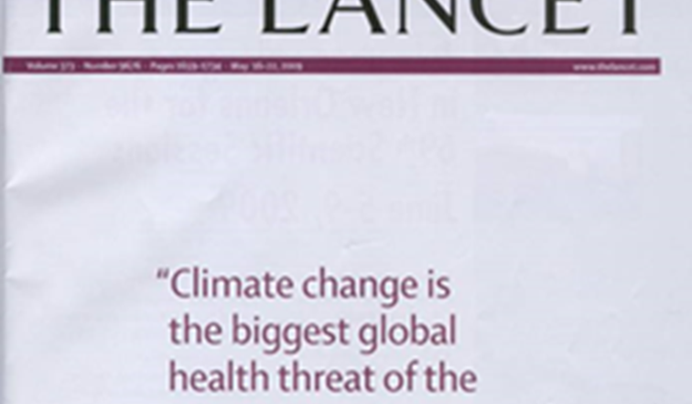
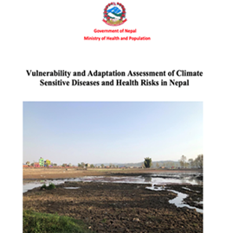
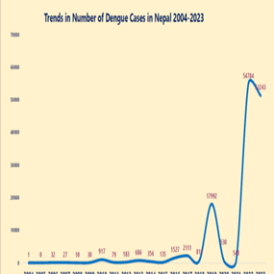
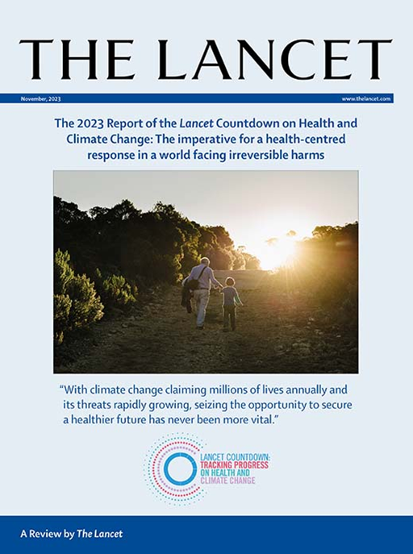
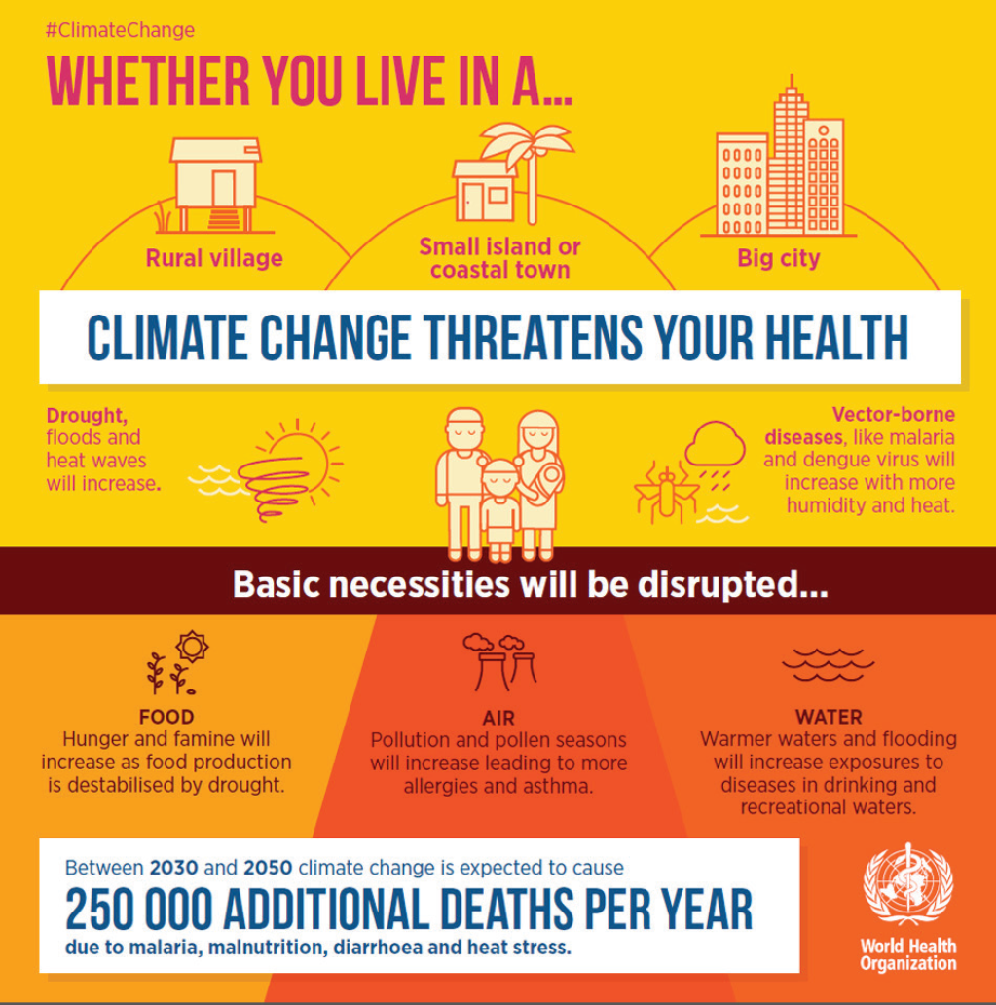
Climate Sensitivity & Health

Slide 4
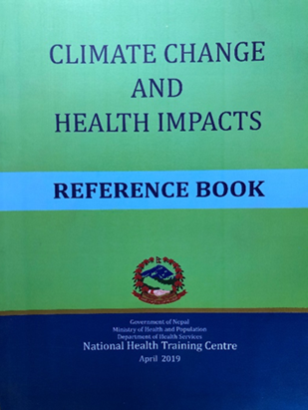
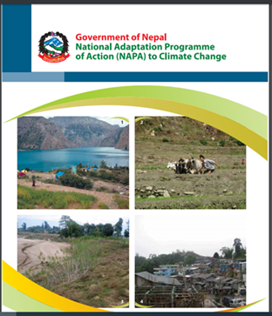
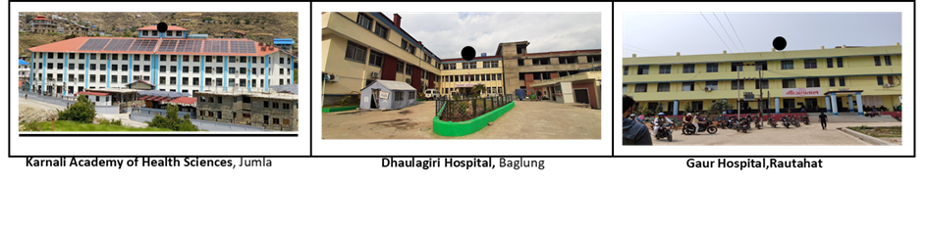
Response towards climate resilient health system
Policy Documents
National Climate Change Policy 2019
National Health Policy 2019
Second Nationally Determined Contributions (NDC), 2020
National Adaptation Plan, 2021
Nepal Health Sector – Strategic Plan (2023 – 2030)
Health National Adaptation Plan (H-NAP) (2023-30)
Key Interventions
Advocacy and capacity building
Vulnerability and Adaptation Assessment (VAA)
Strengthening of climate sensitive diseases surveillance system
Entomological survey
Research
Climate resilience and environmental sustainability of HCFs
Baseline assessment of GHG emissions from health sector
Climate resilient WASH

Slide 5
Climate Change and …
WASH
Nutrition
AMR
SRHR
Eye
Disability
Air Quality
Others

Slide 6
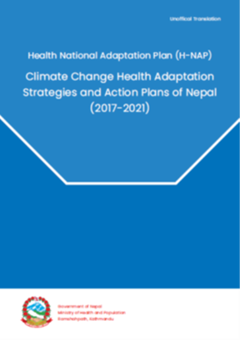
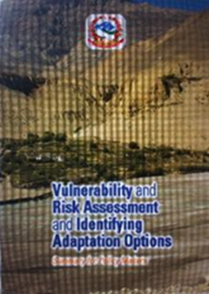







Slide 7
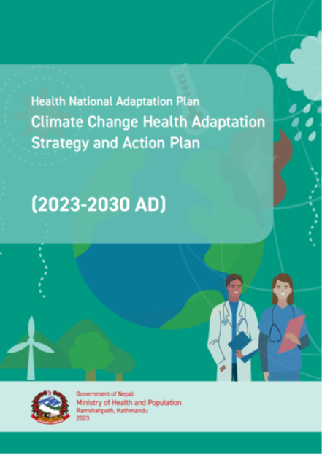
Health National Adaptation Plan
(2023-30)
1. Raise awareness, advocacy and build capacity on climate change.
2. Manage the identification, prevention, control and treatment system of climate sensitive health risks including development of disease surveillance, preparedness and response system.
4. Mainstream climate change adaptation in health policies, strategies, and plans at federal, provincial, and local levels.
3. Develop and promote environment friendly and climate-resilient physical infrastructure and technologies.
5. Raise awareness, advocacy and Collaborate and coordinate with multi-stakeholders to minimize health risks through study, research and knowledge promotion on climate change and health.

Slide 8
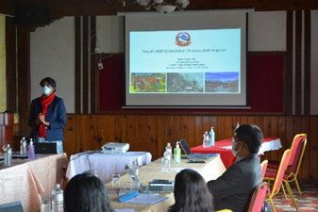
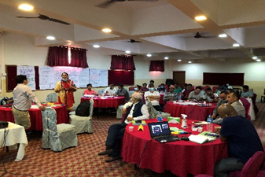
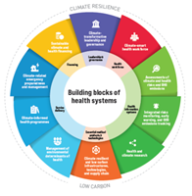
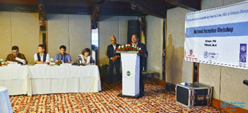
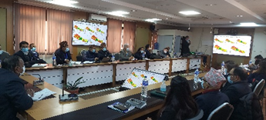
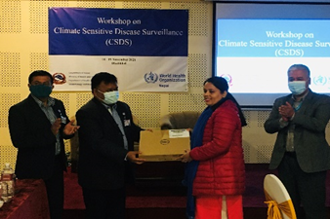
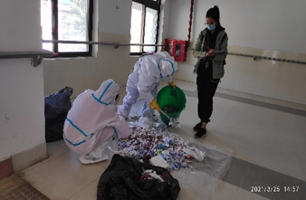
WHO Nepal supporting to
build climate resilient and sustainable low carbon health system
Integration of health in overall NAP
Training of health professionals
Access to GEF funding
VAA of health sector
Piloting of CSDS at sentinel sites
Climate resilience & env sustainability at facility level

Slide 9

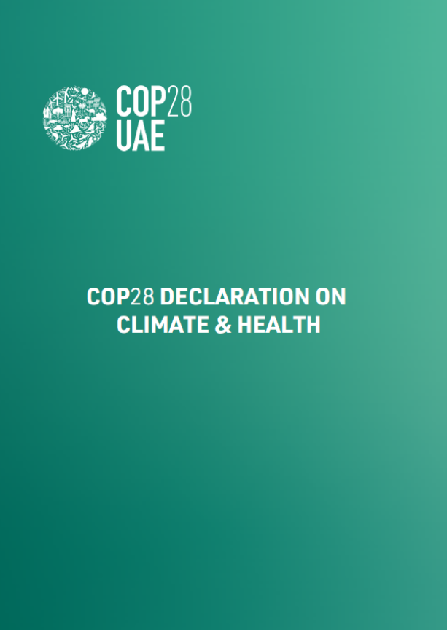

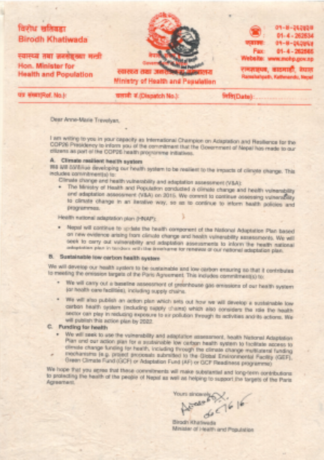

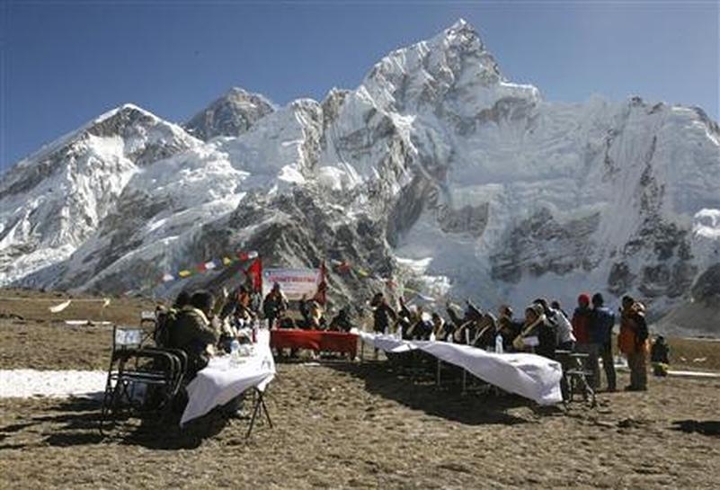


COP 3 (1997), Kyoto
COP 29 (2024), Baku
Global Commitments
COP 28 (2023), Abu Dhabi
COP 26 (2021), Glasgow
COP 21 (2015), Paris
COP 16 (2010), Cancun
COP 15 (2009), Copenhagen
COP 1 (1995), Berlin
Notes:
COP29 health outcomes:
1. Formal announcement of the Baku COP Presidencies Continuity Coalition for Climate and Health
2. Launch of the WHO COP29 Special Report
3. Launch of Quality Criteria for Integrating Health in NDCs
4. Continued work on health indicators under the Global Goal on Adaptation
$300 billion/year instead of demanded $1.3 trillion
New Collective Quantified Goal (NCQG)

Slide 10

Towards low carbon health system in Nepal
Notes:
The inventory accounted the emissions and removals from the following four sectors:
• Energy;
• Industrial processes and product use (IPPU);
• Agriculture, forestry, and other land use (AFOLU); and
• Waste.

Slide 11
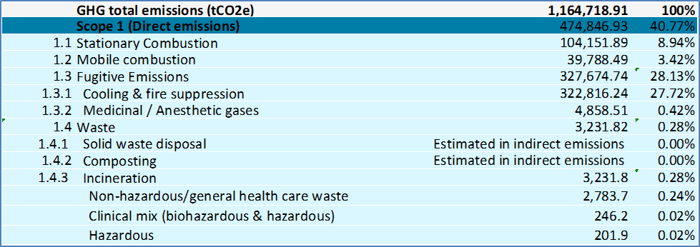
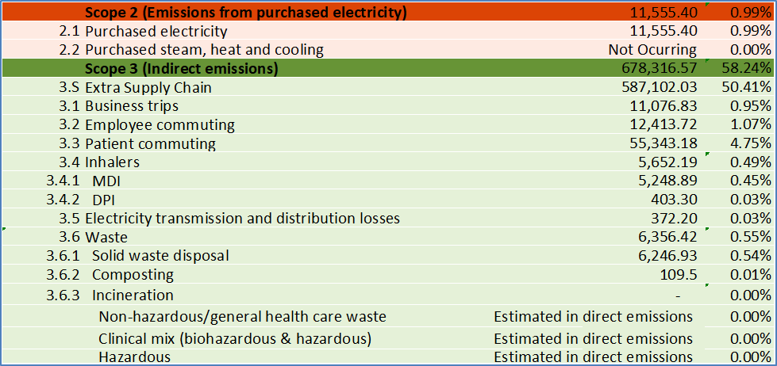
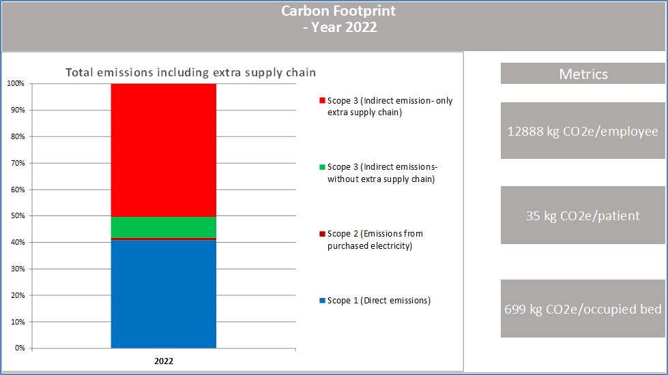
Total CO2e emissions from HCFs in Nepal in 2022 was 1,164,719 tons.
Notes:
The highest contributor of GHG emissions per source was contributed by extra supply chain (50%) followed by cooling and fire suppression (28%), stationary combustion (9%), and others (13%).

Slide 12
Nationally Determined Contribution
(NDC3.0)
Manage healthcare waste using non-burn technologies in 1400 Healthcare Facilities (HCFs) by 2030 and 2800 HCFs by 2035
By 2030, climate-sensitive disease surveillance will be strengthened in 152 sentinel sites, expanding to all municipalities by 2035. By 2030, 500 health professionals will be trained on climate change and health, increasing to 5,000 by 2035.
By 2030, a national and three provincial-level Vulnerability and Adaptation Assessments (VAA) will be carried out, increasing to two national and seven provincial-level VAAs by 2035. The Health National Adaptation Plan (H-NAP) will be updated by 2030.
The disease burden attributed to ambient and household air pollution will be reduced to 77/100,000 by 2030 and 60/100,000 by 2035.
By 2035, 75% of traditional inhalers and anesthetic gases used in the health industry will be replaced with low GHG alternatives

Slide 13
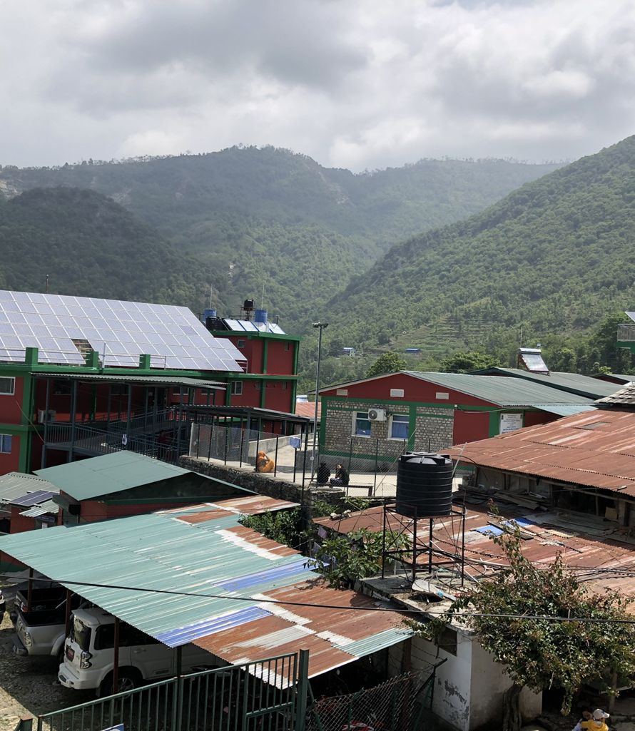
Way forward towards addressing greatest health threat of 21st century
Health at the center of Climate agenda
H-NAP implementation through integration of climate change issues in health programmes
Enhancing adaptive capacity to reduce health vulnerability at local levels through sharing of national/international good practices and knowledge
Health co-benefits through mitigation measures
Leverage sustained large scale global climate finance

Slide 14

Thank You
Notes:
The threat of climate change to the right to health

