Slide 1
Saleh Aljadeeah
Dr. Aljadeeah is a pharmacist with research interest on:
Access to essential medicines in humanitarian settings and health systems research with a focus on pharmaceutical policies.
Currently, he is a post-doctoral researcher at the Institute of Tropical Medicine, Antwerp, Belgium.
He will share his experiences on various risks and hazards associated with pharmaceutical waste and how it is emerging as a neglected environmental threat.

Slide 2
Pharmaceutical waste in the environment: a neglected threat
Aljadeeah, S.*¹, Van Den Noortgate, J.², D’Hondt, R.², Bradley, H.³, Coetzee, R.³. Ravinetto, R.^{1,3}
¹Department of Public Health, Institute of Tropical Medicine, BELGIUM
²Environmental Health Unit, Médecins Sans Frontières, Operational Centre Brussels (MSF-OCB), BELGIUM
³School of Public Health, University of the Western Cape, SOUTH AFRICA.

Slide 3
Outline
Why pharmaceuticals in the environments?
The magnitude of the issues
Drivers and pathways of pharmaceutical waste into the environment
The way forward

Slide 4
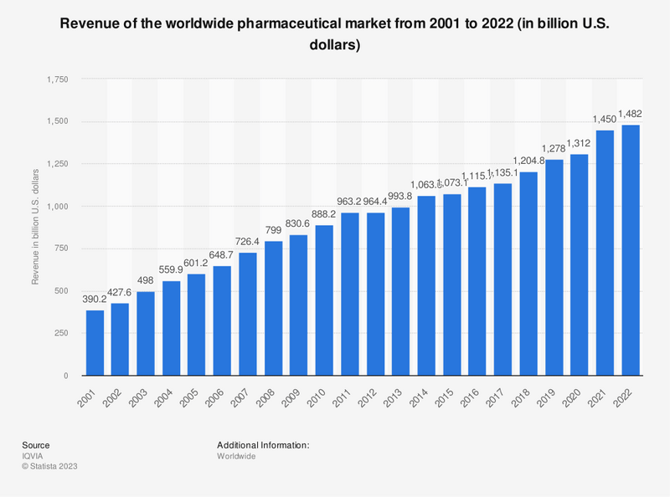
Why pharmaceuticals in the environments?
Pharmaceuticals impact on human and animal health: treating and preventing diseases.
Global consumption of pharmaceuticals: demographic changes, aging populations, increased access to healthcare and pharmaceuticals, increased incidence of NCDs, increase of infectious disease transmission, including coupled to water-, vector- and food-borne pathogens.

Slide 5
Why pharmaceuticals in the environment?
Pharmaceutical pollution is increasingly recognized as an environmental risk globally: pharmaceuticals and their residues can reach the environment throughout their lifecycle and have been found in all environmental compartments, e.g., soil, surface and ground waters, detected at different levels, with potential harmful environmental effects.
Pharmaceuticals are often resistant to inactivation or degradation, sometimes with toxic and bioaccumulating traits. Being produced and used in large quantities, they can have direct and indirect harmful consequences on non-target organisms in the environment.

Slide 6
Why pharmaceuticals in the environment?
Eco-pharmacovigilance: “Surveillance of the effects of drug residues in the environment, such as antibiotics, psychoactive drugs, and hormones, on human health and livestock” (Wang et al. 2018).
Biologically active compounds are specially designed to be effective even at low concentration levels. Pharmaceuticals in the environment may thus have adverse impacts on the health of human beings or other nontargeted organisms after long-term exposure.

Slide 7
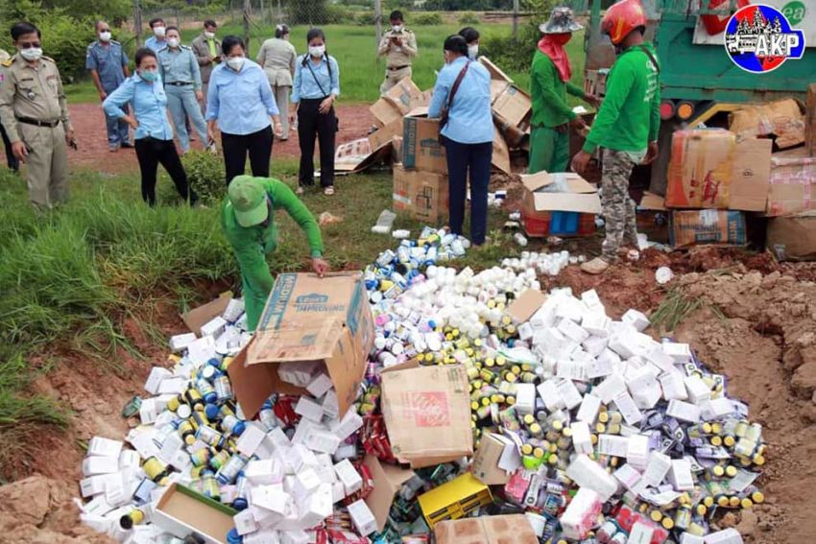
The magnitude of the issue
Research on pharmaceuticals in the environment dates to the 1940s: the first reports concern the environmental presence of antibiotics, triggering antimicrobial resistance (Demerec, 1945; Barber, 1947; Miller, 1948).
Over time, more and more studies have reported residues from more than 600 human and veterinary pharmaceuticals in environment.
According to OECD, environmental toxicity data are lacking for 88% of medicines, and (public) data on pharmaceutical environmental concentrations are not available in most countries.
Environmental effects of pharmaceutical are not consistently monitored and/or regulated across countries.
Source: The Phnom Penh Post

Slide 8
The magnitude of the issue
Global Chemicals Outlook II, UNEP, 2019

Slide 9
Drivers and pathways into the environment
Pharmaceutical waste:
Manufacturing plants: by-products of manufacturing processes, and rejected batches;
Healthcare facilities: expired products, and leftovers;
Households: unused or expired medicines.

Slide 10
Drivers and pathways of pharmaceutical waste into the environment
Global overview of disposal practices used by general public for unused/unwanted or expired medicines from households (Paut Kusturica M, Tomas A et al., 2017).

Slide 11
Drivers and pathways of pharmaceutical waste into the environment
Pharmaceutical Residues in Freshwater. OECD (2019)

Slide 12
Drivers and pathways of pharmaceutical waste into the environment
An excess of waste is triggered by poor stock management and irrational use.
Pharmaceutical waste requires specific, safe processing, but inadequate disposal is common.
Many resource-limited countries lack (adequate) regulation on safe disposal, and/or the infrastructure to conduct it correctly, e.g. semi-industrial incinerators.
During conflicts and natural disasters, challenges are aggravated by poor donation practices: unsolicited pharmaceuticals with past or near expiry dates, or not usable for other reasons, reach countries that cannot use them nor implement safe elimination.

Slide 13
Drivers and pathways of pharmaceutical waste into the environment
During conflicts and natural disasters, challenges are aggravated by poor donation practices:
unsolicited pharmaceuticals with past or near expiry dates, or not usable for other reasons, reach countries that cannot use them nor implement safe elimination.
Source: MSF-OCB

Slide 14
The way forward
Comply with the UN Environment Programme Strategic Approach to International Chemical Management (SAICM) (2015): https://www.unep.org/explore-topics/chemicals-waste/what-we-do/emerging-issues/environmentally-persistent-pharmaceutical
A policy on Environmentally Persistent Pharmaceutical Pollutants (EPPPs) which urges to address the problem and protect human and environmental health globally.
Implement adequate stock management & (rational) prescription and use of medicines.
Every unnecessary or inappropriate prescription/use, as well as overstocking, creates the pre-requisite for pharmaceutical waste.
Design and implement regulation on safe disposal, including the availability of the infrastructure needed to conduct it correctly.

Slide 15
The way forward
Affordability
Availability
Sustainability
access
Quality
Acceptability
Appropriate use
Accessibility
(Wirtz et al 2016) & (Pharmaceutical Management framework, 2012)

Slide 16
The way forward
Preventing the environmental contamination with pharmaceutical wastes, or mitigating its effects, is a complex undertaking.
Involvement of stakeholders include regulators, the pharmaceutical industry, supply officers, MoH, health facilities, prescribers, the academia, the communities, etc.
Global health researchers, in particular, should engage in multidisciplinary projects, linking-up with environmental health and pharmacy experts, in order to:
describe the causes and extent of pharmaceutical waste by regions;
test the effectiveness, safety and feasibility of context-adapted disposal methods;
guide policymakers to minimize pharmaceutical pollution, and related harm to public health and the environment.

Slide 17
Q&A

Slide 18
Thank you!
Saleh Aljadeeah
saljadeeah@itg.be

