Slide 1
How clinical research can advance health outcomes in Nepal: implications from the World Health Assembly resolution on clinical trials
Vasee Moorthy FRCP PhD
Senior Advisor
Research for Health Department
Science Division
WHO, Geneva
Nepal National Summit of Health and Population Scientists, 10 April 2024

Slide 2
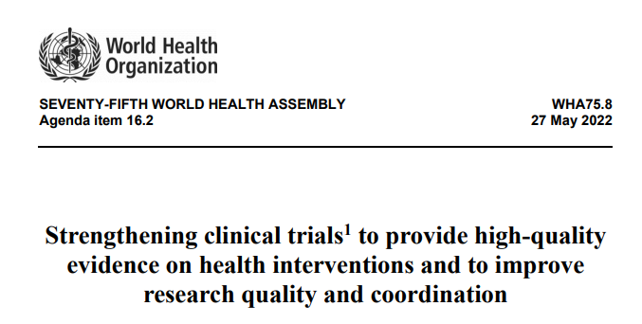
In 2022 all Member States adopted a resolution calling for strengthening of clinical trials to provide high quality evidence

Slide 3
Research Processes as a Cycle rather than a Linear Pathway
Designing and Conducting the research
Reporting results and sharing data
Evidence synthesis and Policymaking
Implementing the interventions
Prioritizing research questions
Important to consider clinical trials as part of broader health research ecosystem…
… And to consider how best to link research capacity strengthening to health systems strengthening

Slide 4






R&D ecosystem
Health R&D ecosystem
Regulation and manufacturing
Basic and Preclinical Research
Clinical Research
Social Science Research
Knowledge Translation
Implementation Research
Important to consider clinical trials as part of broader health research ecosystem…
… And to consider how best to link research capacity strengthening to health systems strengthening

Slide 5
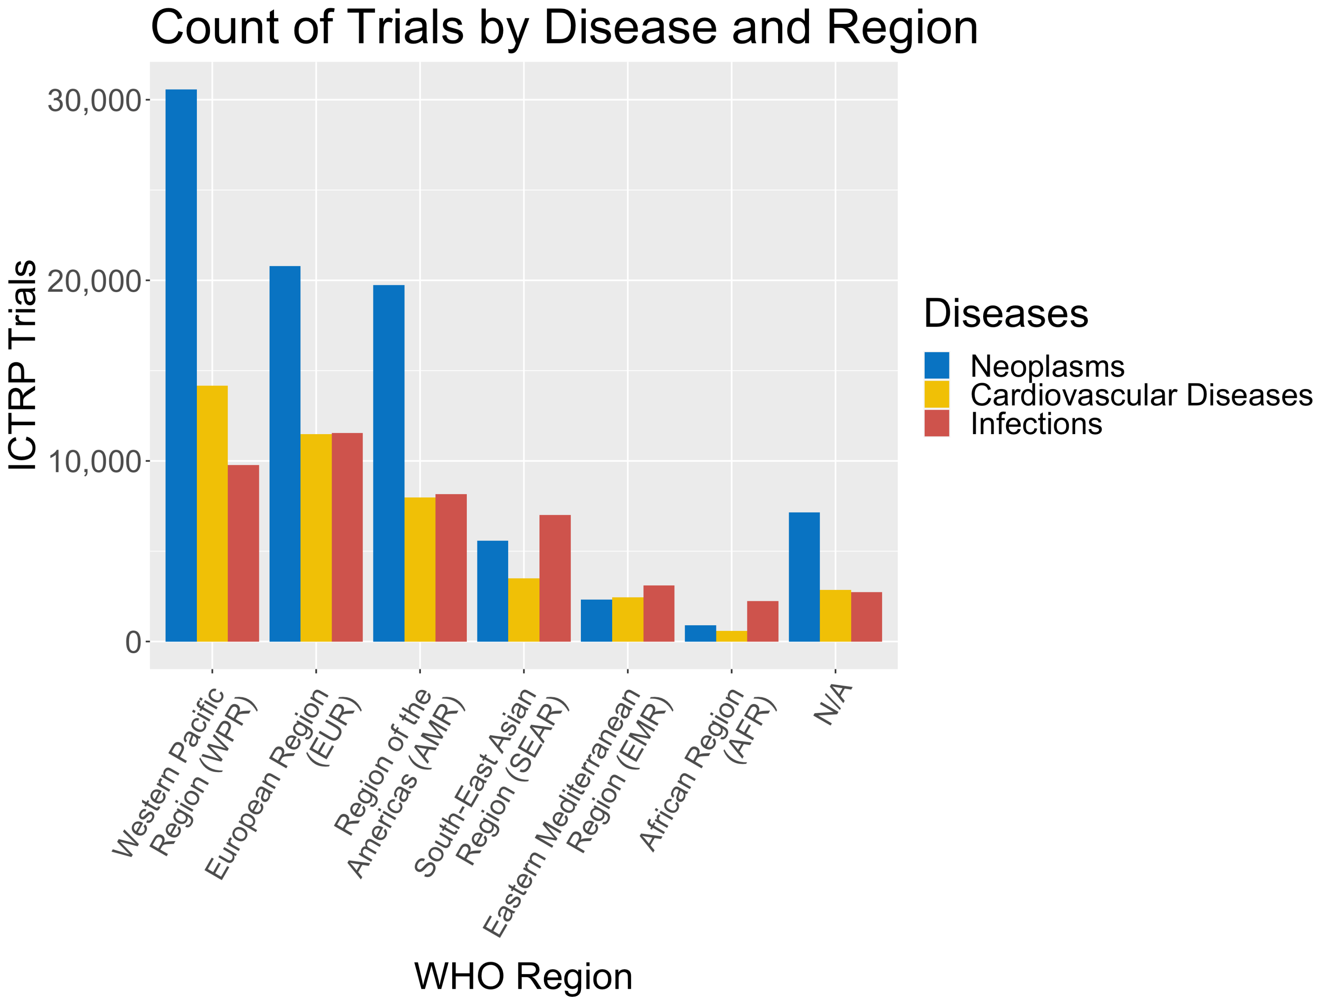
Mapping of clinical trials by disease area and region
Clinical trials from 2018-2022 were mapped to WHO regions as well as the disease areas neoplasms, cardiovascular diseases, and infections
Disease areas were defined using Medical Subject Headings ( https://www.ncbi.nlm.nih.gov/mesh/)

Slide 6
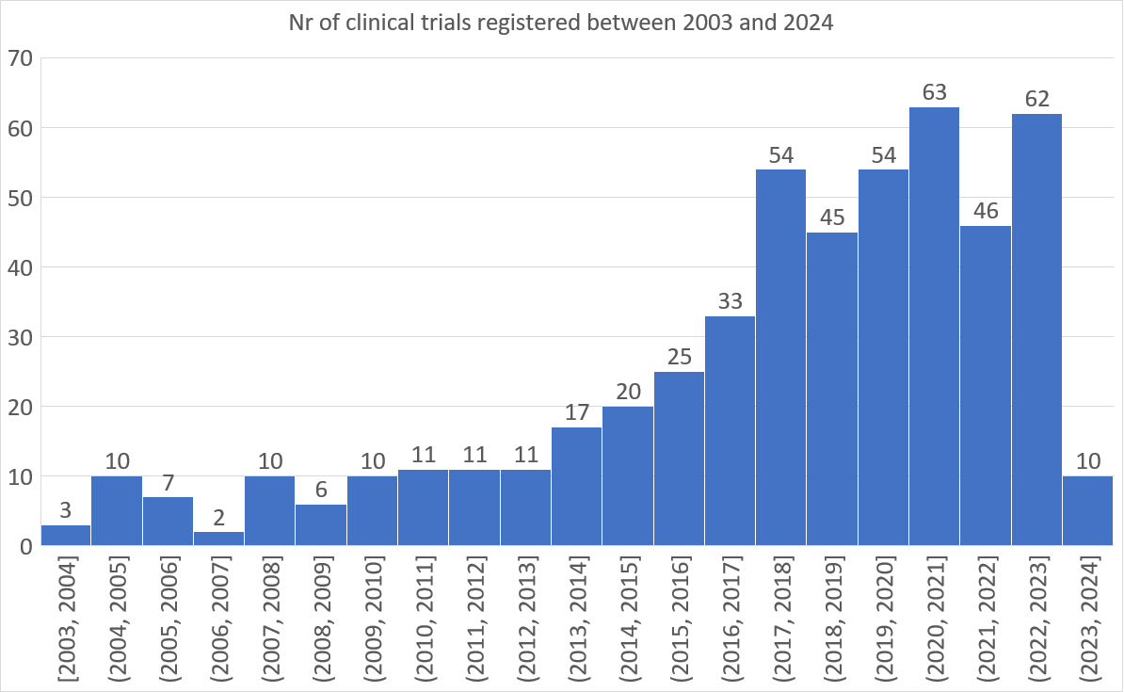
Nepal trial registrations in WHO ICTRP
ICTRP search portal (who.int)

Slide 7
Key problem statements with the current clinical trial ecosystem
Regulatory systems involving multiple approval bodies may be overly complex and not always proportionate to risk; as a result of this complexity, good trials are too expensive, take too long, … costing many lives
  How can we advance the benefits of compelling well-designed trials while maintaining appropriate safeguards? How to accelerate benefits of adaptive, platform trials?
Many trials do not contribute to high quality evidence: NB most uninformative trials are likely in high income countries, because most trials are in high income countries
  Most health policy/guidelines recommendations are not based on high certainty evidence (Intern Med J 2020 Jan;50(1):30-37) and therefore most decision-making is not based on high certainty evidence
  There are insufficient “levers” to prevent badly designed trials that will not answer the scientific question
Major gaps in clinical infrastructure and capabilities exist in many countries with high disease burdens; existence of capacities in high income countries does not guarantee efficient conduct of informative trials

Slide 8



Guidance
TAG constituted
Mapping
Networks
Consultations
4th Member State consultation completed
Online training materials to be developed in coordination with ICH, Ethics, Funders
Funding
National Regulations
Sites/institutional capacities
Regional consultations: PAHO Oct 4-5, AFRO Oct 17-18, SEARO, Nov 10-11, EMRO Nov 14-15
Global forum meeting with stakeholders (clinical researchers, ethics, regulatory, funders, patient, community organizations, private sector)
Public consultation July to September
Likely to be finalized in 2024
Private sector consultations: Geneva, May & Kigali October 2023

Slide 9
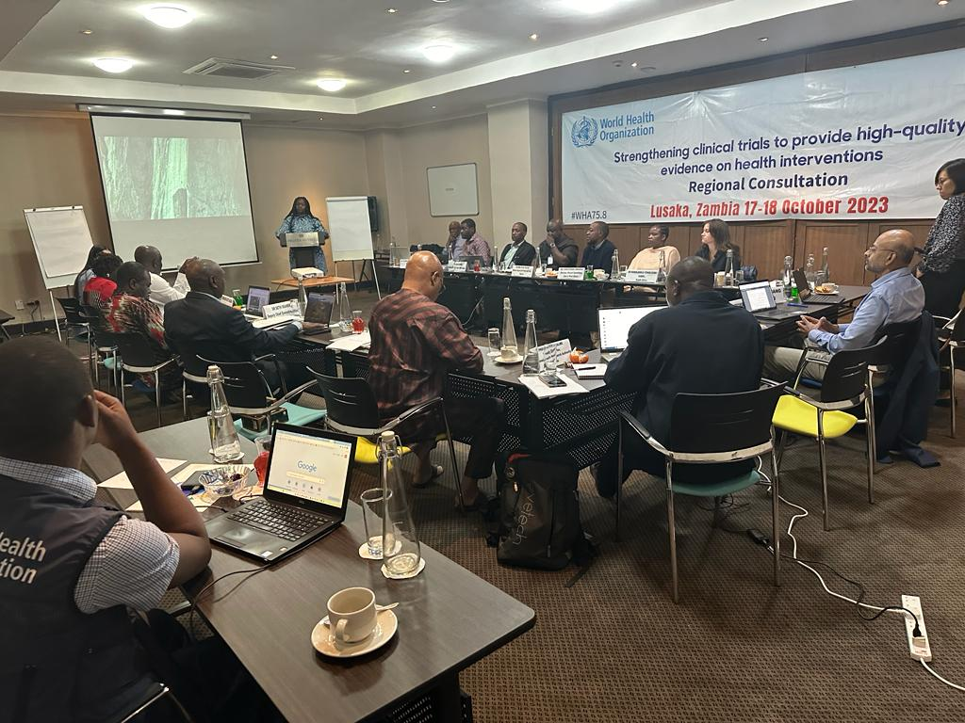
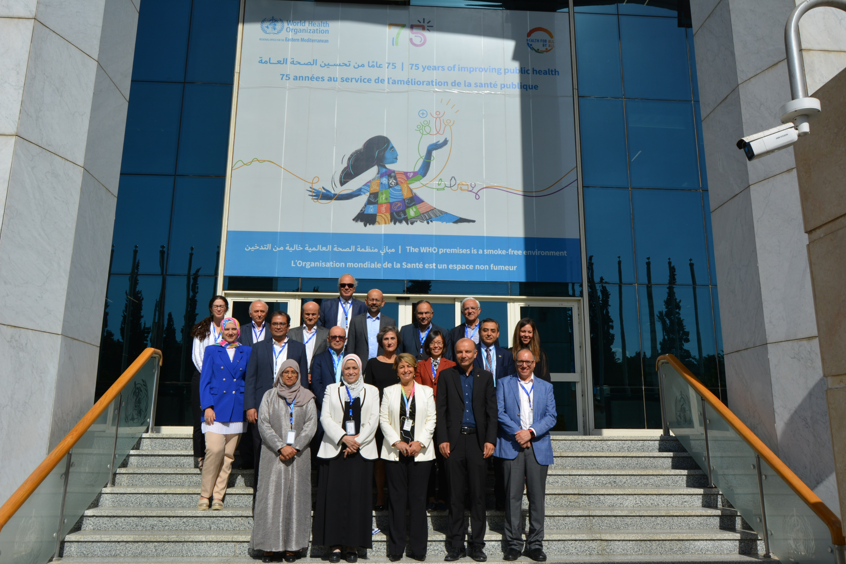


Slide 10


Slide 11
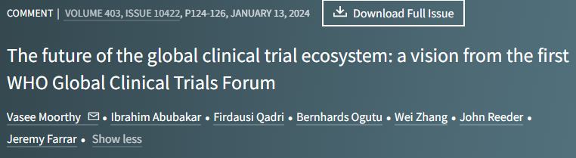
Similar issues emerged from the regional consultations, leading to an agreed global vision

Slide 12
Key areas of focus for capacity development going forwards according to inputs received during regional consultations
Developing capabilities for research sustainably, linked to health systems, and kept “warm” through ongoing well designed clinical research; moving away from a “vertical” to a “horizontal” approach while keeping the best aspects of the vertical.
Prioritisation for identified trials aligned between stakeholders
Enabling international collaborations
Improving capacities and efficiency in regulatory and research ethics systems; how to ensure a focus on the key issues in an efficient and risk proportionate way
Improving efficiency and coordination between elements of the trials ecosystem
Ensuring scientific validity and social value of research
Patient and community engagement norms in clinical trials
Supporting newer models for RCTs (including integration into healthcare, adaptive, platform, digital)

Slide 13
Sustainable Strong Continuous National
Clinical Research Ecosystems
Enabling national clinical research governance
Continuous financing
Institutional and individual clinical research capacity
Engagement
Underrepresented populations
Research ethics oversight including efficiency
Regulatory systems including efficiency
Continuous strengthening through monitoring, evaluation and learning (MEL)

Slide 14
Key themes: Vision emerging from the global forum
  “Always on, Always busy” – move to ongoing trials all the time for endemic use cases, which can pivot in times of crisis
  Risk proportionate approaches to well-designed and well-implemented trials
  Domestic funding, enabling trials linked to sustained capacities and priorities
  Embedding under-represented populations in the whole process
  Centrality of patient and community engagement in clinical research
  Models for large scale trials embedded into health systems

Slide 15
Urgent reforms needed to enable key trials
  expansion of global south leadership for all key aspects of trials
  ongoing sustained capacity rather than project funding alone
  single REC review for clinical trials or effective REC coordination
  single submission systems for REC and NRA review
  parallel not sequential reviews
  coordinated approval processes between regulators and ethics
  ensuring scientific validity
  master clinical trial agreements
  overcoming barriers to importation of investigational products

Slide 16
WHO maturity framework for clinical trial units
A self-assessment and benchmarking tool to guide the capacity development in clinical trials
Phase 1: development (2024/25)
Led by HQ with support from ROs and WCOs
Phase 2: implementation (2026/27)
Led by ROs with support from WCOs and HQ
Step 1: scoping
Led by HQ with support from ROs
Step 2: drafting
Led by HQ with support from ROs
Step 3: piloting
Led by ROs with support from HQ and WCOs
Feedback integration for draft indicators, data collection and analysis plan, model action recommendations
Pilot outcome feedback, recommendation for revision
Launch
Relevant scope and areas in reviewed framework
Agreed structure for framework
Set of draft indicators with explanation
Final framework
Country pilot and national workshop on validation and feedback
Revision and finalization of framework, data collection and analysis manual
Scoping review of CTU capacity assessment
WHO internal review and expert consultations
Drafting CTU maturity framework
Online and in-person regional, global stakeholder consultations
External collaborators
Steering group, TAG, key global stakeholders
Expert collaborators
Steering group, TAG, global and regional stakeholders
National stakeholders, external collaborators
External collaborators
2024.Q2
2024.Q3
2024.Q4
2025.Q1
2025.Q2
2025.Q3
2025.Q4
Working groups:
Steering group: WHO regional advisors on research, selected country offices, staff of relevant technical programs in HQ
Technical Advisory Group (TAG) of Clinical Trials
External collaborators: contracting or collaborating research institutes or experts
Stakeholders: global, regional or national interest institutions and individuals

Slide 17
2023
2024
National capacities in NRAs
Ethics committees
Research institutions
Patient/ Community engagement in research
Inter-agency harmonization/ coordination
Functional clinical research networks performing key trials
Mapping
Guidance Development
Consultations
Enabling environment
Implementation tool Development
Support for capacity development

Slide 18
Other major activities in WHO Research for Health Department
Guidance on:
Health Foresight
AI and health
Genomics
Responsible life sciences research / dual use research
Human genome editing
Guidance on:
Global Observatory on health R&D
ICTRP (trial search portal)
Research priority setting
WHO Target Product Profiles
WHO Coordinated Scientific Advice
Product Development Partnerships
Access to paediatric medicines
Evidence to policy good practices

Slide 19
Conclusion
Enabling the following:
  Sustainable clinical research capacities that enable ongoing clinical research that meets local and global needs:
  Locally led strengthening of national trials ecosystems: strive for efficiency – address bottlenecks
  Effective prioritization for use of these capacities
  Addressing under-represented populations
  Risk proportionate approaches to well-designed and well-implemented trials.

Slide 20


Funding Acknowledgement

