Slide 1
Prevention and Control of NCDs, Injuries and Mental Health in Nepal: Situation and Future Directions
10th National Summit of Health and Population Scientists in Nepal
Advancing Health and Population Research and Innovations: Achieving SDGs, 10-12 April 2024
Krishna Aryal¹, Kedar Marahatta², Sanjeev Neupane³, Achyut Raj Pandey¹, Meghnath Dhimal ⁴
¹University of Bergen, Bergen, Norway,
²WHO Country Office, Kathmandu, Nepal,
³University of the West of England, Bristol, UK,
⁴Nepal Health Research Council, Kathmandu, Nepal

Slide 2
Presentation Outline
Situation analysis incl. epidemiological situation of NCDs Injuries and Mental Health
Global recommendations for prevention and control of NCDs
Nepal’s health system response to NCDs, Injuries and Mental Health
Opportunities, challenges & future directions

Slide 3
Approach of the Thematic Presentation
Theme selection/ assignment
Review of Literature
Recommendations
A part of position paper on NCDs, Injuries and Mental Health
Review of literature – both national and international evidence, & national documents
Recommendation based on the documents review and contextual analysis

Slide 4
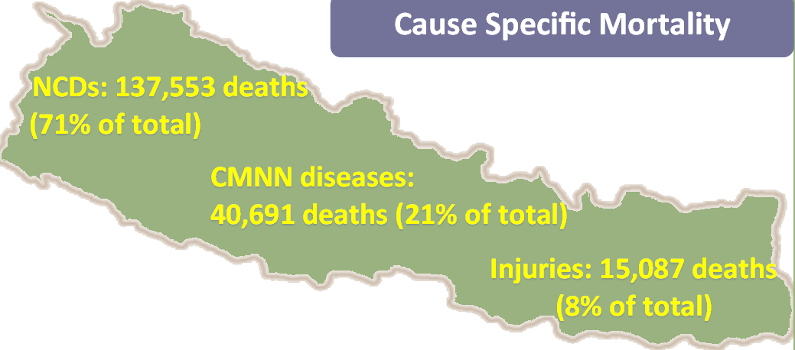
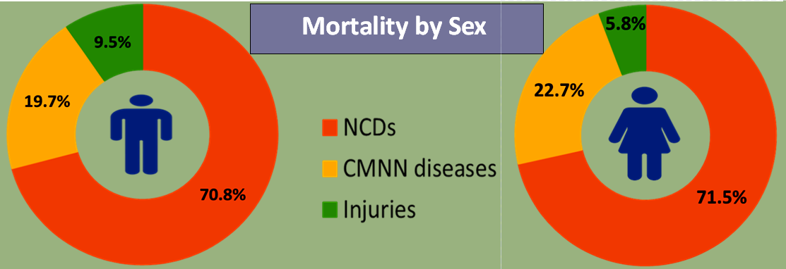
Cause of Mortality

Slide 5
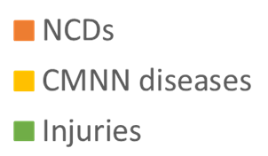
Overall Burden of Disease - DALYs
Notes:
Sex wise – for injuries – higher among Men..
For other two categories – more or less similar

Slide 6
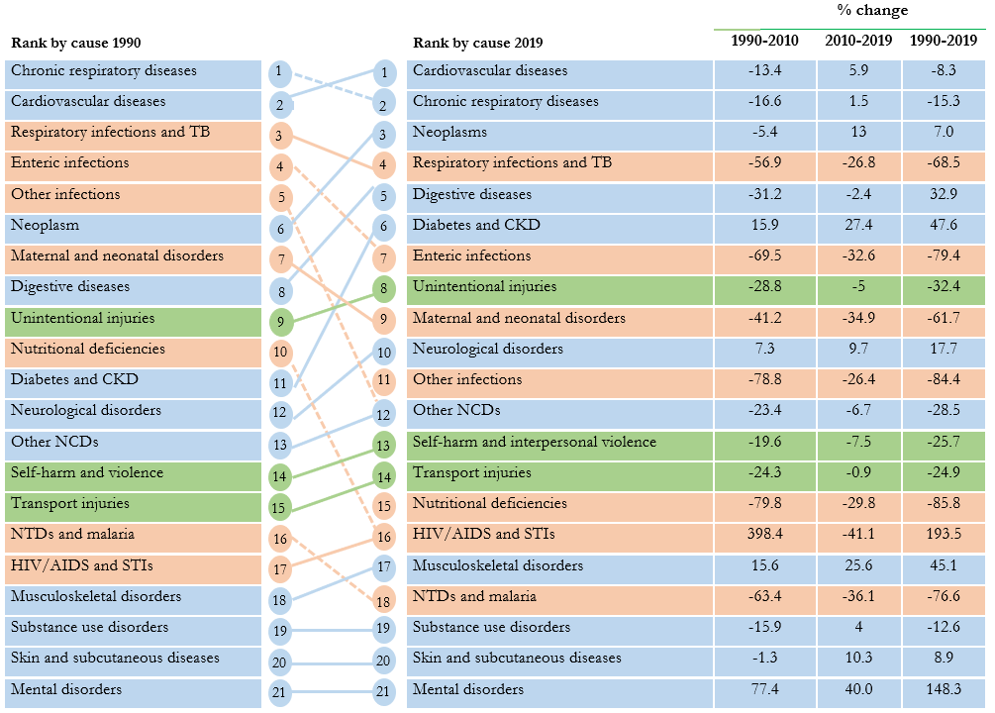
Causes of Mortality
What disease conditions caused most deaths in Nepal in 2019
 | Both* | Male* | Female*
Cardiovascular diseases | 24.0 (21.7-26.8) | 26.8 (23.9-31.1) | 20.7 (17.3-24.1)
Chronic respiratory diseases | 21.1 (16.9-23.6) | 18.9 (14.3-21.4) | 23.8 (16.7-27.8)
Neoplasms | 11.2 (10.1-12.2) | 10.8 (9.5-11.9) | 11.6 (10.2-13.7)
Respiratory infections and TB | 8.4 (7.3-9.5) | 8.7 (7.3-10.1) | 8.1 (6.5-9.6)
Digestive diseases | 5.9 (4.8-7.8) | 6.4 (5.1-9.5) | 5.2 (4.3-6.4)
Maternal and neonatal disorders | 5.2 (4.4-6.2) | 4.5 (3.6-5.7) | 6.1 (5.2-7.1)
Diabetes and kidney diseases | 4.4 (3.7-5.1) | 4 (3.3-5.3) | 4.9 (3.8-5.9)
Unintentional injuries | 4.2 (3.7-5.2) | 4.5 (3.9-5) | 3.8 (3-5.9)
Enteric infections | 3.6 (2.2-5.8) | 2.5 (1.5-4.2) | 4.9 (2.4-9.5)
Neurological disorders | 2.3 (1.4-4.6) | 1.9 (1.2-3.6) | 2.8 (1.5-5.8)
Self-harm and interpersonal violence | 2.1 (1.7-2.5) | 3.2 (2.4-3.8) | 0.8 (0.6-0.9)
Other infectious diseases | 1.9 (1.3-2.6) | 1.9 (1.3-2.5) | 1.9 (1.2-2.7)
Other NCDs | 1.8 (1.3-2.3) | 1.6 (1.1-2.2) | 2.1 (1.5-2.7)
Transport injuries | 1.5 (1.2-1.8) | 1.8 (1.2-2.2) | 1.2 (1-1.4)
HIV/AIDS and STIs | 1 (0.1-4.6) | 1.2 (0.1-5.7) | 0.7 (0.2-4)
Nutritional deficiencies | 0.7 (0.5-0.9) | 0.5 (0.4-0.7) | 0.9 (0.7-1.2)
NTDs and malaria | 0.3 (0.1-0.5) | 0.4 (0.1-0.7) | 0.2 (0.1-0.3)
Musculoskeletal disorders | 0.2 (0.2-0.3) | 0.1 (0.1-0.2) | 0.3 (0.2-0.5)
Substance use disorders | 0.1 (0.1-0.2) | 0.2 (0.1-0.3) | 0 (0-0)
Skin and subcutaneous diseases | 0 (0-0) | 0 (0-0) | 0 (0-0)
Mental disorders | 0 (0-0) | 0 (0-0) | 0 (0-0)
Age standardised mortality rates
* Percentage of deaths attributed to the specified disease conditions
Notes:
It includes several different types of NCDs like malignant carcinoid tumor, neuroendocrine tumor, Leiomyoma, benign neoplasms of uterus and other different forms of tumor, postinfectious hypothyroidism and other several conditions. Details can be found at Global Burden of Disease Study 2019 (GBD 2019) Cause List Mapped to ICD Codes

Slide 7
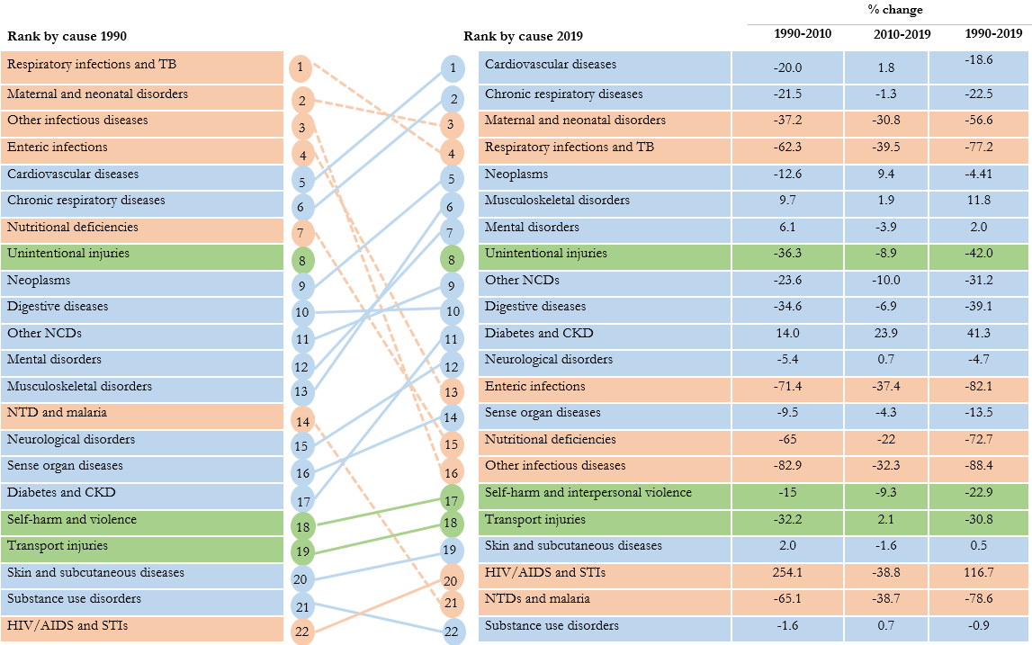
Causes of DALYs
What disease conditions caused most DALYs in 2019
 | Both* | Male* | Female*
Cardiovascular diseases | 11.9 (10.1-13.8) | 14.3 (11.9-17) | 9.4 (7.7-11.3)
Maternal and neonatal disorders | 10.4 (8.9-12.1) | 10.2 (8.6-12.1) | 10.6 (9-12.3)
Chronic respiratory diseases | 9.8 (7.9-11.3) | 9.1 (7-10.5) | 10.5 (7.7-12.5)
Respiratory infections and TB | 7.7 (6.6-8.9) | 8.2 (6.9-9.7) | 7.2 (5.9-8.6)
Neoplasms | 6.8 (5.7-7.8) | 6.7 (5.6-7.8) | 6.8 (5.5-8.3)
Mental disorders | 5.5 (4.2-7) | 4.7 (3.6-6) | 6.4 (4.9-8)
Musculoskeletal disorders | 5.4 (4.2-6.7) | 3.8 (2.9-4.9) | 7.1 (5.5-8.7)
Other non-communicable diseases | 5 (4.1-6.2) | 3.5 (2.7-4.6) | 6.6 (5.5-8.1)
Unintentional injuries | 4.9 (4.4-5.4) | 5.3 (4.6-5.9) | 4.6 (4.1-5.1)
Digestive diseases | 4.3 (3.5-5.6) | 5 (4-6.9) | 3.6 (3-4.4)
Diabetes and kidney diseases | 3.9 (3.4-4.4) | 3.9 (3.3-4.6) | 3.8 (3.2-4.4)
Neurological disorders | 3.7 (1.9-6.2) | 3.1 (1.7-4.9) | 4.4 (2.2-7.4)
Enteric infections | 3.5 (2.6-4.7) | 3.1 (2.3-4.2) | 4 (2.8-6)
Nutritional deficiencies | 2.7 (2-3.5) | 2.1 (1.5-2.8) | 3.3 (2.5-4.3)
Self-harm and interpersonal violence | 2.6 (2.1-3.1) | 4 (3.1-4.8) | 1.2 (1-1.4)
Other infectious diseases | 2.6 (1.8-3.6) | 2.6 (1.8-3.6) | 2.6 (1.7-3.7)
Sense organ diseases | 2.5 (1.8-3.5) | 2.3 (1.6-3.3) | 2.8 (2-3.9)
Transport injuries | 2 (1.6-2.2) | 2.9 (2.1-3.3) | 1.1 (1.0-1.2)
Skin and subcutaneous diseases | 1.6 (1.1-2.2) | 1.4 (1-2.1) | 1.7 (1.2-2.3)
HIV/AIDS and STI | 1.3 (0.3-5.3) | 1.5 (0.2-6.6) | 1 (0.3-4.3)
NTDs and malaria | 1.1 (0.8-1.4) | 1.2 (0.8-1.5) | 1 (0.8-1.3)
Substance use disorders | 0.7 (0.6-0.9) | 1 (0.8-1.3) | 0.4 (0.3-0.6)
Age standardised DALY rates – Change over time
* Percentage of DALYs attributed to the specified disease conditions
Notes:
It includes several different types of NCDs like malignant carcinoid tumor, neuroendocrine tumor, Leiomyoma, benign neoplasms of uterus and other different forms of tumor, postinfectious hypothyroidism and other several conditions. Details can be found at Global Burden of Disease Study 2019 (GBD 2019) Cause List Mapped to ICD Codes

Slide 8
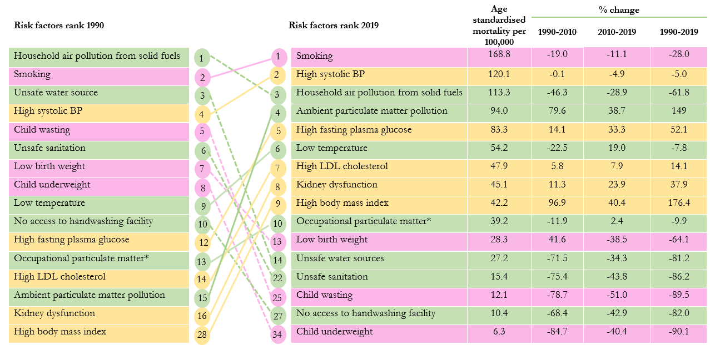
Risk factors attributing to death between 1990 and 2019
What risk factors are responsible for deaths in Nepal
Age standardised mortality rates – Change over time
Leading risk factors for deaths (2019)
Risk factors | % of attributable deaths
Smoking | 17.7
High systolic BP | 12.3
Household air pollution | 11.2
Ambient air pollution | 9.3
High fasting plasma glucose | 8.0
Low temperature | 4.9
High LDL cholesterol | 4.9
High body-mass index | 4.7
Kidney dysfunction | 4.7
Low birth weight | 4.3

Slide 9
NCD Risk Factors
Deaths
DALYs
Notes:
Deaths

Slide 10
NCD Risk Factors
Karnali
Behavioral risk factors
Sudurpaschim
Tobacco use:30%
Alcohol use: 23%
Inactivity: 4%
High BMI: 11%
Nepal
Current tobacco use: 29%
Current alcohol use:24%
Insufficient physical activity: 7.4%
High BMI: 29%
Tobacco use:34%
Alcohol use: 32%
Inactivity: 2%
High BMI: 11%
Gandaki
Tobacco use:26%
Alcohol use: 29%
Inactivity: 10%
High BMI: 35%
Sudurpaschim
Karnali
Bagmati
Tobacco use:23%
Alcohol use : 33%
Inactivity: 10%
High BMI: 43%
Koshi
Gandaki
Tobacco use :23%
Alcohol use : 25%
Inactivity: 4%
High BMI: 25%
Lumbini
Bagmati
Lumbini
Tobacco use :36%
Alcohol use : 21%
Inactivity: 7%
High BMI: 20%
Koshi
Madhesh
Madhesh
Tobacco use :29%
Alcohol use : 12%
Inactivity: 9%
High BMI: 20%
*Inactivity-Insufficient physical activity
Harmful use of alcohol 7.0% all adults (13.1% of men, 1.8% of women)
Notes:
Provincial differences esp on High BMI, demanding contextualized interventions
Harmful use – Heavy episodic drinking (consumed 6 standard drinks or 60g of pure alcohol or more drinks on any single occasion in the past 30 days)

Slide 11
NCD Risk Factors
Salt intake and perception
Karnali
Sudurpaschim
Mean Salt intake: 10 g/day
Think lowering salt as important: 75%
Nepal
Mean salt intake:9 grams
Think lowering salt is important: 80%
Mean Salt intake:9 g/day
Think lowering salt as important: 83%
Gandaki
Mean Salt intake :9 g/day
Think lowering salt as important: 78%
Sudurpaschim
Karnali
Bagmati
Mean Salt intake :9 g/day
Think lowering salt as important: 78%
Koshi
Gandaki
Mean Salt intake :9 g/day
Think lowering salt as important: 72%
Lumbini
Bagmati
Lumbini
Mean Salt intake :9 g/day
Think lowering salt as important:82%
Koshi
Madhesh
Madhesh
Mean Salt intake :9 g/day
Think lowering salt as important: 85%
Notes:
While 80% think that reducing salt intake is important, why is salt intake double of the recommended level?

Slide 12
NCD Risk Factors
Biological risk factors
Karnali
Sudurpaschim
Hypertension:21%
Diabetes: 1%
High cholesterol: 4%
CVD risk*: 4%
Nepal
Hypertension:25% Diabetes: 6%
High cholesterol: 11% CVD risk≥ 30: 3%
Hypertension:21%
Diabetes: 4%
High Cholesterol: 9%
CVD risk*: 10%
Gandaki
Hypertension:30%
Diabetes: 3%
High cholesterol:13%
CVD risk*: 4%
Sudurpaschim
Karnali
Bagmati
Hypertension:25%
Diabetes: 4%
High cholesterol:8%
CVD risk*: 2%
Koshi
Gandaki
Hypertension:27%
Diabetes: 4%
High lipid:14%
CVD risk*: 3%
Lumbini
Bagmati
Lumbini
Hypertension:28%
Diabetes: 6%
High cholesterol: 12%
CVD risk*: 2%
Koshi
Madhesh
Madhesh
Hypertension:19
Diabetes: 11%
High cholesterol: 12%
CVD risk*: 3%
*30% or higher predicted 10-year CVD risk
Notes:
Provincial differences esp on HTN and DM, demanding contextualized interventions

Slide 13
Population based prevalence of NCDs
Selected Chronic Disease
Karnali
Sudurpaschim
CKD:5%
COPD: 25%
CAD definite: 0.0%
Nepal
CKD: 6%
COPD: 12%
CAD definite: <1%
CKD:6%
COPD: 14%
CAD definite: 0.6%
Gandaki
CKD:7%
COPD: 6%
CAD definite: 0.6%
Sudurpaschim
Karnali
Bagmati
CKD:7%
COPD: 12%
CAD definite: 0.9%
Koshi
Gandaki
CKD:5%
COPD: 6%
CAD definite: 0.6%
Lumbini
Bagmati
Lumbini
CKD:6%
COPD: 10%
CAD definite: 0.2%
Koshi
Madhesh
Madhesh
CKD:7%
COPD: 16%
CAD definite: 0.2%
Notes:
High COPD rates in Karnali, Su Pa and Madhesh – demanding acceleration of interventions

Slide 14
Population based prevalence of Mental Disorders
Mental problems
Karnali
Sudurpaschim
Mental disorder:12%
Suicidal thought: 10%
Suicidal attempt: 1%
Nepal
Mental disorder (lifetime): 10%
Suicidal thought (current): 7%
Suicidal attempt (lifetime): 1%
Mental disorder:10%
Suicidal thought: 5%
Suicidal attempt: 1%
Gandaki
Mental disorder:11%
Suicidal thought: 5%
Suicidal attempt: 1%
Sudurpaschim
Karnali
Bagmati
Mental disorder:12%
Suicidal thought: 7%
Suicidal attempt: 2%
Koshi
Gandaki
Mental disorder:14%
Suicidal thought: 10%
Suicidal attempt: 1%
Lumbini
Bagmati
Lumbini
Mental disorder:13%
Suicidal thought: 10%
Suicidal attempt: 1%
Koshi
Madhesh
Madhesh
Mental disorder:2%
Suicidal thought: 2%
Suicidal attempt: 0.4%
Other Conditions
Currently having mental disorders: 4%
Alcohol use disorders 4%
Child & adolescent with mental health issues: 20%

Slide 15
Average annual increase by 7.4% from 2015 – 2020. The increase is more than 14% in 2021 and has gone back to usual rate in 2022
Annual deaths due to Suicide

Slide 16
Injuries and Related Factors
In 2019, 3.8% reported involvement in a road traffic crash in past 12 months. (STEPS 2019)
NDHS 2022
Deaths due to road traffic injuries – 14/100,000 population (M – 11/100,000, F – 3/100,000)
Nonfatal injuries due to road traffic accidents or crashes: 1,088 individuals per 100,000 population (F – 301/100,000 & M – 787/100,000)
Motorcycle accidents – 68% of deaths and injuries
Nepal Police – 2883 RTA deaths in 2021 (2251 in 2019)

Slide 17
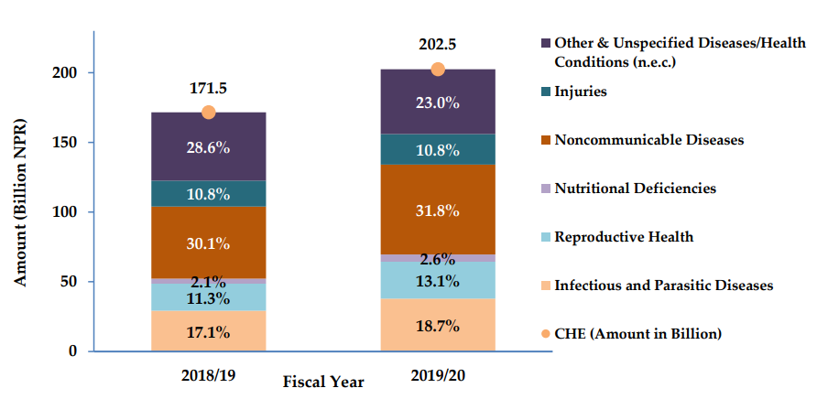
NCDs and Health Expenditures
CHE Distribution by Diseases/Health Conditions in FYs 2018/19 & 2019/20
Source: Ministry of Health and Population, National Health Accounts 2018/19-2019/20
Notes:
Source: Ministry of Health and Population,. National Health Accounts 2018/19-2019/20

Slide 18
NCDs and Health Expenditures
Comparison of disease burden and health budget for the year 2019/20
Source: Nepal Health Research Council: A Comparative Analysis of National Burden of Diseases and Health Budget in Nepal (2019/2020)
Notes:
Comparison of disease burden and health budget for the year 2019/20

Slide 19
Response – Policies, Strategies and Interventions

Slide 20
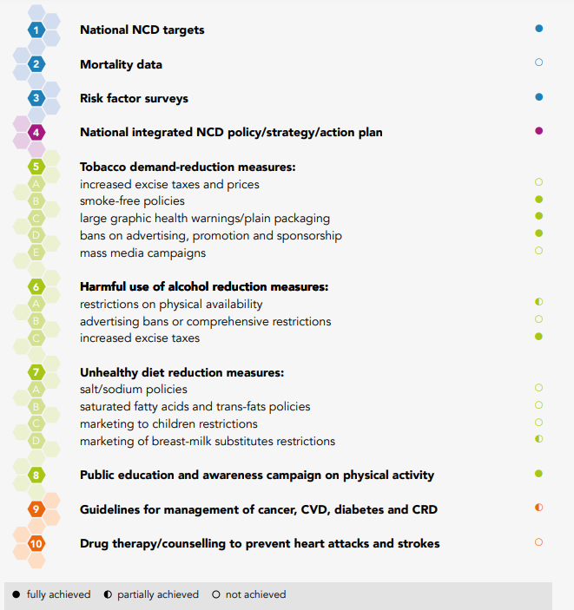
Where Nepal stands in terms of NCD response

Slide 21
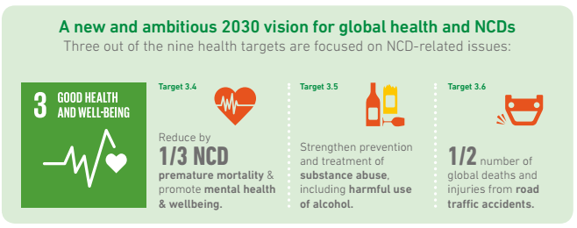
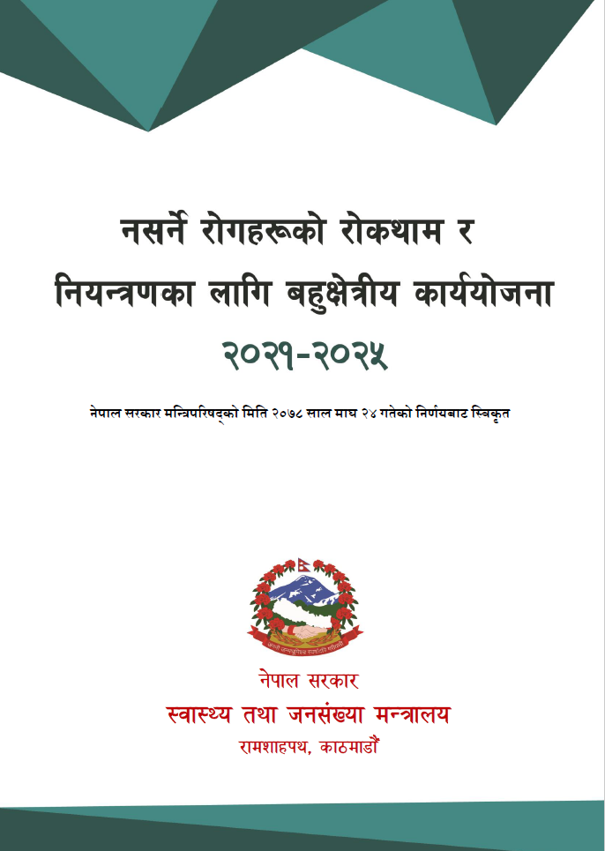
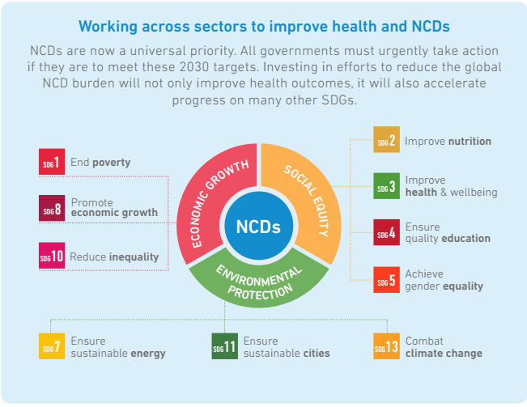
Addressing NCDs – Agenda 2030 (The SDGs) Time for Action on NCDs

Slide 22
NCD Action Plan 2021-2025
Vision - Healthy and productive citizens free of preventable NCDs
Goal – Reduce the BoD due to NCDs through “Health in all policy approach”
Targets by 2025
25 % reduction in NCD mortality
50% of eligible people receive drugs and counseling
80% access to affordable basic medicines, technologies, etc
Other services
25% increase in cancer patients receiving palliative care
15% increase in caries free children 6 yrs old
25% increase in service coverage of mental disorders
Raised BP 25% reduction
Halt the rise in Obesity
Halt the rise in diabetes
Harmful use of Alcohol- 10% reduction
Tobacco- 30% reduction
Physical inactivity
10% reduction
Salt -30% reduction mean intake
Recommended fruits & veg intake – 10% increase
25% women (30-49) screened for cervical cancer
Solid fuel use for cooking - 50% reduction

Slide 23
NCD Action Plan 2021-2025 - Approach
1. Advocacy, leadership, and partnership
4. Surveillance, M and E, research
2. Health promotion and Risk Reduction
3. Health system strengthening for early detection & management of NCDs & risk factors
Strategic approach for implementation
Four Action Areas
SUSTAIN
High Level political commitment
ACCELERATE
Implementation of the action plan addressing health impact of environment, tobacco, alcohol, unhealthy diet and physical inactivity
INNOVATE
Explore effective strategy for implementation and strengthen advocacy for commitment, resource allocation and regulatory enforcement

Slide 24
National Health Policy 2076
01
DIETARY RISK FACTORS
02
03
RESPONSIBILITY OF PREVENTION
SERVICES
Individuals, families, societies and concerned agencies shall be made responsible for prevention and control of NCDs and integrated health system shall be developed and expanded
In order to improve nutritional situation, adulterated and harmful foods shall be discouraged and promotion, production, use and access to quality and healthy foods shall be expanded
Mental health, oral, eye, ENT (ear, nose and throat) health services shall be developed and expanded

Slide 25
NHS-SP 2023-2030
GOAL
OUTCOMES
OUTPUTS
•Reduced adverse effects of wider determinants on health
•Citizens responsible for their own, family and community health
•Institutional and policy provisions for addressing social determinants of health
•Multisectoral collaboration to address social determinants of health
•Changed/improved behavior of citizens for healthy lifestyle
•Improved health status of every citizen

Slide 26
National Programs & Strategies on Mental Health
National MH Program
National Mental Health Program 2022
Governance
Other MH initiatives
Child Mental Health
Resources
11 mental health medicines are integrated into National list of free essential medicine
National Mental Health Strategy and Action Plan 2020
Mental health interventions are covered in social health insurance schemes
MH has been included in Basic Health Care Package
Disability rights act 2017
National suicide prevention helpline 1166
Mental health in social protection initiatives such as n OCMC
Abut 200 psychiatrists + 30 new psychiatrists added each year
Tele mental health national guideline
Recording and reporting tool integration

Slide 27
Focused MH service at district level hospitals as per new national program
National Mental Health Strategy and Program
National Mental Health Strategy and Action Plan 2077
Integration of mental health at Primary Health Care level
Strengthening mental health at Secondary Health care level
Service user engagement in policy development and planning
Train Primary Care Team
Care coordination and Mentor Primary Care
Support district hospitals
Health Assistants and Communtiy Medical Assistants
Nurses
Primary care doctors
Designated telephone time everyday
WhatsApp/Viber groups
Weekly zoom calls
Visits district hospital every month
Supervise district team
Organize learning session
Provide referral care
Designated MH team at district hospital: a mental health nurse (full time) and a psychiatrist part time

Slide 28
खुला मन (‘Khula Man’) facility initiative a measure of quality assurance as per new national program
Designated space for MH
Trained human resources available
Use of national training/protocol/guidelines
Supply of essential medicines
Patients' rights always respected in service delivery
Initiative to improve quality of care
Coordination of referrals
Recording reporting

Slide 29
Suicide Prevention
Other Programs on Mental Health
Mental Health service expansion
Media guideline on responsible reporting on suicide
Emotional wellbeing of adolescents – school mental health
Collaboration with agriculture sector for preventing pesticide suicide
Suicide Prevention National Helpline 1166
Child and adolescent mental health
Integrated Care Delivery
Integration of child and adolescent mental health at district hospitals by building capacity of GP, pediatrician & Mos
School mental health program
A package of interventions
6-day training program to train school nurse and orient teachers

Slide 30
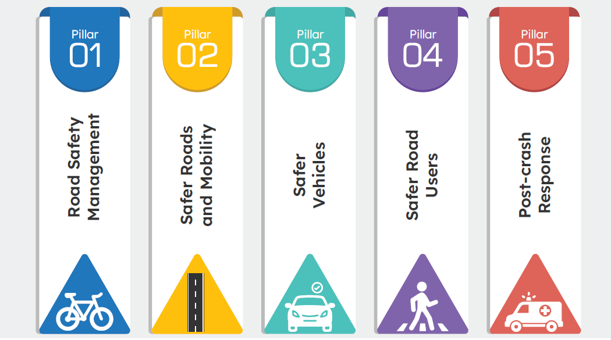
Nepal Road Safety Action Plan 2021-2030
Goal
In line with SDG 3.6 on road safety – the goal is to reduce road traffic deaths and injuries by 50%
Five Pillars of Road Safety Action Plan

Slide 31
Global Recommendations

Slide 32
WHO Best Buys
Best Buys-28 interventions
(Tobacco use, harmful use of alcohol, unhealthy diet, physical inactivity, CVDs, Chronic respiratory diseases, cancer)
Additional interventions – countries could pick based on the context and relevance
Updated “Best Buys” and “Good Buys”

Slide 33
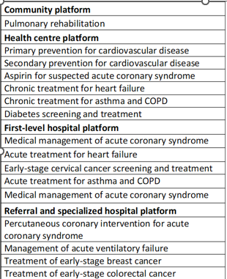
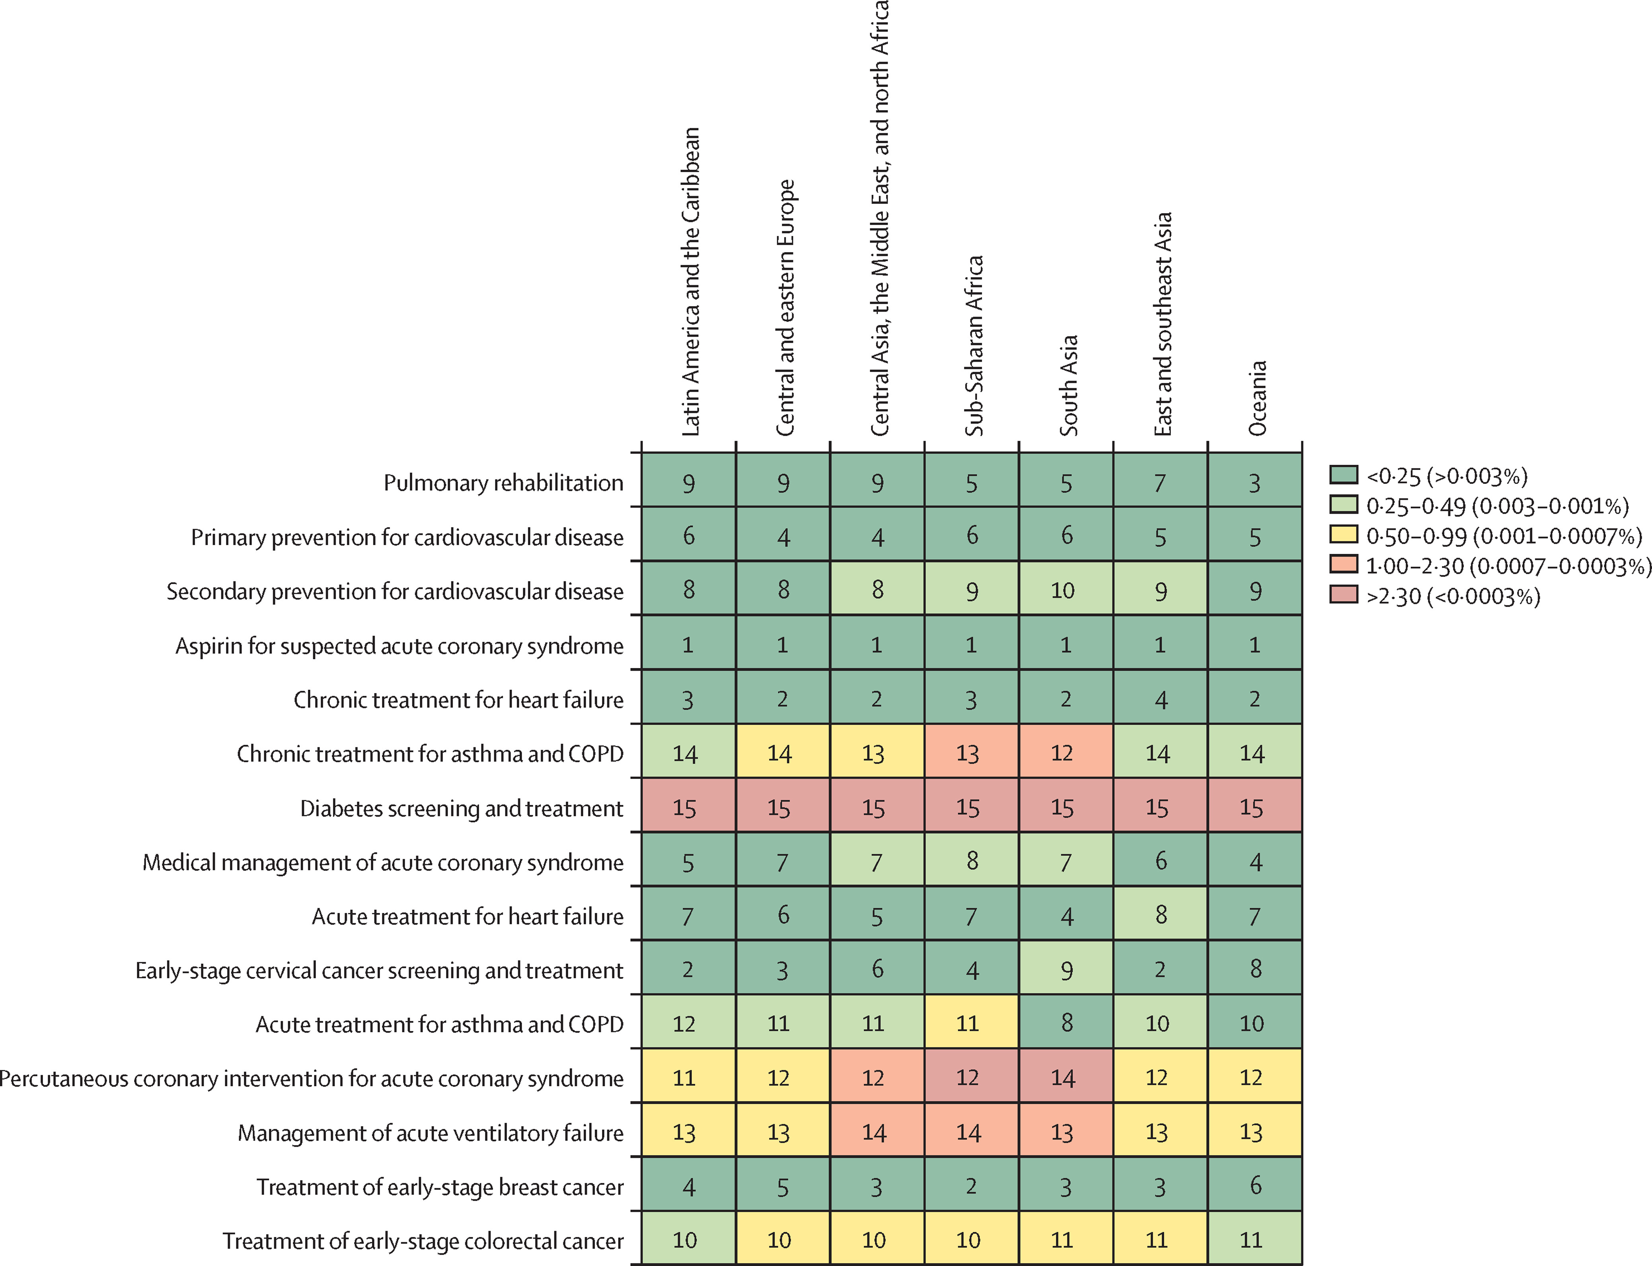
Disease Control Priorities (DCP3)
NCD Countdown 2030 analysis based on DCP3
Majority align with WHO recommended interventions;
some additional clinical interventions (basic treatments for CVD and respiratory complications)

Slide 34
Current Health System Interventions for NCDs

Slide 35
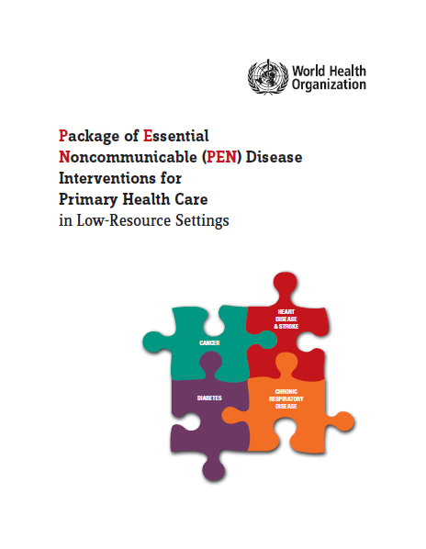
NCD Interventions
Basic Health Service Package
PEN Package
PEN Plus
Initial screening, diagnosis, counseling, continuation of treatment, referral for common NCDs incl. mental disorders, geriatrics health issues, and injuries
Prevention of CVD through integrated management of diabetes & HTN
Complementary package to PEN; initiated from 7 districts
Health education and counseling on healthy behaviors
Management of COPD & Asthma
Screening & referral of breast & cervical cancer
Secondary level (district or equivalent hospitals) for selected major NCDs incl. selected neurodevelopmental disorders
Notes:
PEN Plus - Type I Diabetes and Type II Diabetes (under insulin or with end organ damage); Cardiovascular Diseases including Rheumatic Heart Disease, Acute Rheumatic Fever, Congenital Heart Diseases, Hypertension with end organ damage, Ischemic Heart Diseases; Respiratory Disorders including COPD with Gold classification C & D & Childhood Asthma; Sickle Cell Disease; Cancer including Childhood Cancer, Breast, Oral and Cervical Cancer; Epilepsy and neurodevelopmental disorders including intellectual disabilities, attention deficit hyperactive disorder (ADHD) and Autism.

Slide 36
Other programs/interventions
Nepal Integrated NCD Care Model
Other social health security interventions
PEN Plus
Pilot program with integrated care for improving HTN management at PHC level – 1 district
Treatment of elderly people under Geriatric Health Service Strategy
Complementary package to PEN; initiated from 7 districts
Secondary level (district or equivalent hospitals) for selected major NCDs incl. selected neurodevelopmental disorders
Strengthening essential NCD services – 7 districts
Bipanna Nagarik Aushadi Upachar Program
Notes:
Kidney disease, Heart disease, Cancer, Head Injury, Spinal Injury, Parkinson’s disease, Alzheimer’s disease, Sickle Cell Anemia

Slide 37
Service provision and health seeking behavior

Slide 38
Health Service Availability and Utilization
Service availability and readiness (NHFS 2021)
Service utilization (HMIS;AHR 2079/80)
Health seeking behavior (STEPS 2019)
Chronic respiratory diseases – 96% Cardiovascular diseases – 90%
Hypertension – 630,000 Diabetes – 312,000
9.5% with HTN under treatment; among the rest 79% not aware of having HTN; about half have never measured BP
Diabetes – 73% Mental health – 25%
COPD – 186,000 Mental health cases – 119,000
21% with DM under treatment; 74% not aware of having DM
Notes:
Service utilization – Number of patients taking treatment
Health seeking behavior – out of one quarter population aged 18-69 years with HTN
45% never measured BP

Slide 39
Opportunities, Challenges & Future Directions

Slide 40
Opportunities
Policies, strategies, and plans in place
New initiatives to further strengthen essential NCD & mental health services
People centered care – LLG an opportunity
HMIS – newly added indicators for NCDs & mental health (strengthen monitoring)
Periodic STEPS and other surveys
Integrated care delivery through primary healthcare network
Notes:
People centered care – opportunity to make it happen through effective leadership & engagement of Local Governments
HMIS – newly added indicators for NCDs & mental health (strengthen monitoring)

Slide 41
Challenges
Behavior change communication – more required
Effective implementation of NCD action plan – esp establishing multisectoral stakeholder engagement
Balancing the trade-off with Communicable diseases & RMNCAH conditions (competing priorities)
Not all ‘Best Buys’ included in intervention package; Consideration of other cost-effective interventions
Low general government health expenditures (GGHE) and high out of pocket expenditures (OOPE) (especially for NCDs)
Effective routine monitoring of intervention coverage; & periodic evaluation
Consideration of other cost-effective interventions as per feasibility and context
Notes:
BCC – inadequate as supported by STEPS and other health seeking behavior studies
Mental Health A significant barrier to access to and use of mental health services in Nepal is social and cultural stigmatization. In the National Mental Health Survey in 2020–2021, 15.6% of the adults surveyed reported that they were concerned that they “might be seen as weak for having a mental health problem”, and 10.5% were concerned that they “might be seen as crazy” . In rural areas, treatment of mental health is reported to be strongly stigmatized by the community, resulting in either underutilization of mental health services or compelling people to travel long distances to obtain treatment.
Multisectoral engagement - Dhimal M, Dhimal ML, Dahal S, Shrestha MP, Gyanwali P, Shao R, Mikkelsen B, Wickramasinghe K, Marten R, Jha AK, Townsend N. Barriers and facilitators to the implementation of a national multisectoral action plan for the prevention and control of noncommunicable diseases in Nepal: perspectives of stakeholders. Glob Health Action. 2021 Jan 1;14(1):1963069. doi: 10.1080/16549716.2021.1963069. PMID: 34448675; PMCID: PMC8405092.

Slide 42
Challenges Mental Health & Injuries
Mental Health
Injuries
Inadequate institutional setup and human resources
Inadequate infrastructure and road safety measures
Insufficient training for newly recruited health workers and lack of refresher trainings
Low priority for mental health program at sub-national level
Inadequate supply of medicine and equipment
Access and quality of services in rural and underserved areas is not regulated
Enforcement of traffic laws and regulations
Lack of comprehensive data on RTIs, including reliable reporting mechanisms and surveillance systems
Notes:
Kidney disease, Heart disease, Cancer, Head Injury, Spinal Injury, Parkinson’s disease, Alzheimer’s disease, Sickle Cell Anemia

Slide 43
Future Directions
Review and revision of program interventions
Strengthen enforcement of related policies & regulations
“Best Buys”, “Good Buys” & Other cost-effective interventions
Local evidence incl. recommendation from NCDI Poverty Commission
Review, evaluate and revisit health behavior change related interventions
Integrate community based NCDs, Injuries & Mental Health interventions into existing PHC programs
Integration of age-long healing sciences (Yoga, Naturopathy, Ayurveda) on healthy lifestyles & behaviors into primary care

Slide 44
Future Directions
Monitoring & Evaluation
Research and Financing
Utilize recently developed BHS monitoring framework
Expand surveillance & disease registries
Ensure complete reporting on HMIS indicators
Ensure effective mechanism to track coverage of special initiatives
Review & evaluate special initiatives
Ensure adequate monitoring of outcome & impact level indicators
Effectiveness studies including economic evaluation
Fiscal space analysis – budget alignment as per BoD – priority setting – opportunities to expand fiscal space
Operational and implementation research of interventions
Notes:
Kidney disease, Heart disease, Cancer, Head Injury, Spinal Injury, Parkinson’s disease, Alzheimer’s disease, Sickle Cell Anemia

Slide 45
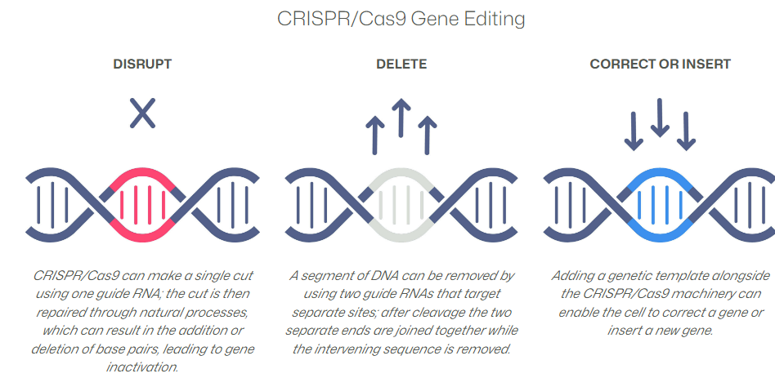
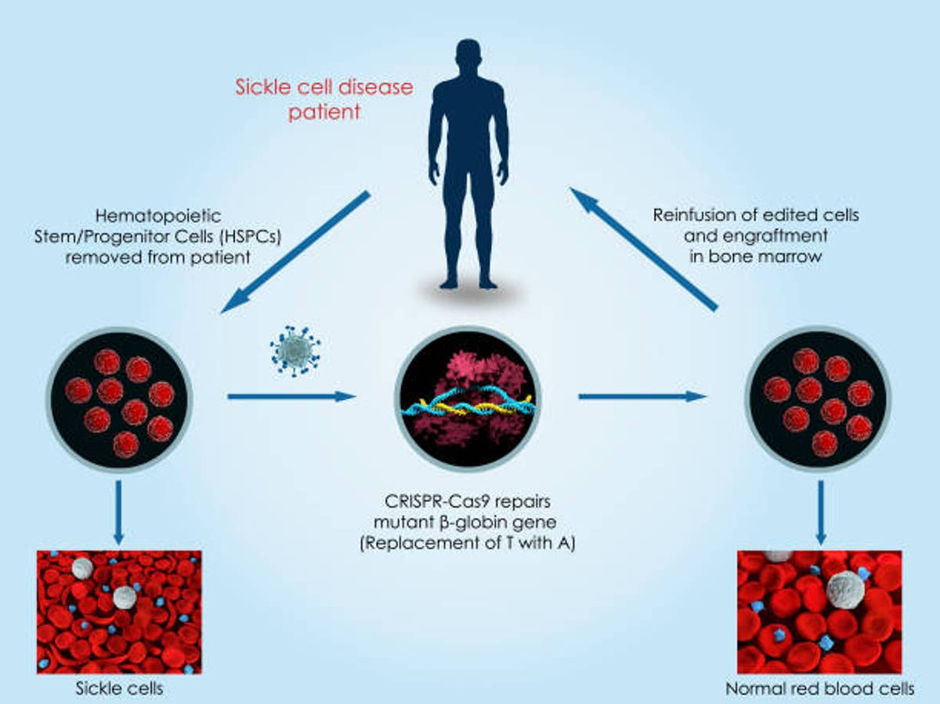
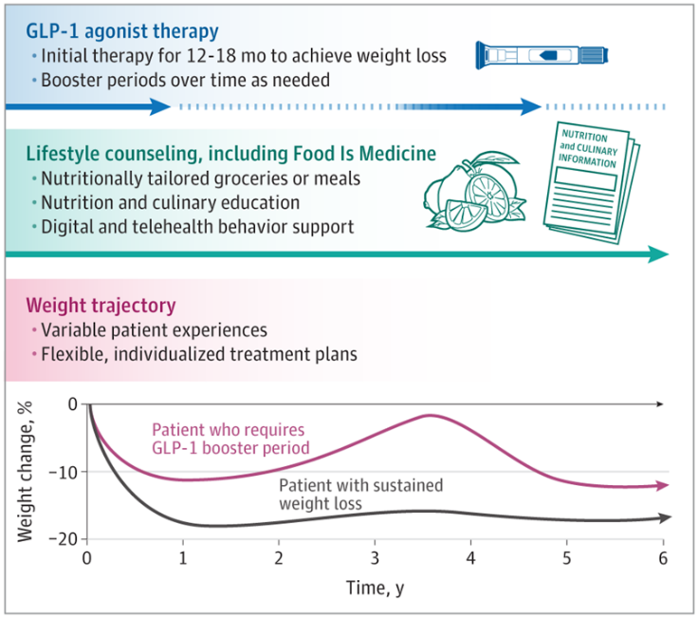
Thank You!!!
Notes:
Crisper Per treatment cost – 2.2 Million USD
GLP1 With ever-rising global adiposity, glucagon-like peptide 1 (GLP-1) agonists are shifting the treatment landscape. In trials, GLP-1 agonists produce placebo-adjusted weight loss of 12% to 18%—exceeding any prior pharmacologic therapy and generating enormous attention and utilization. Cost (with discounts) – USD 6500 per year

